Slide 1

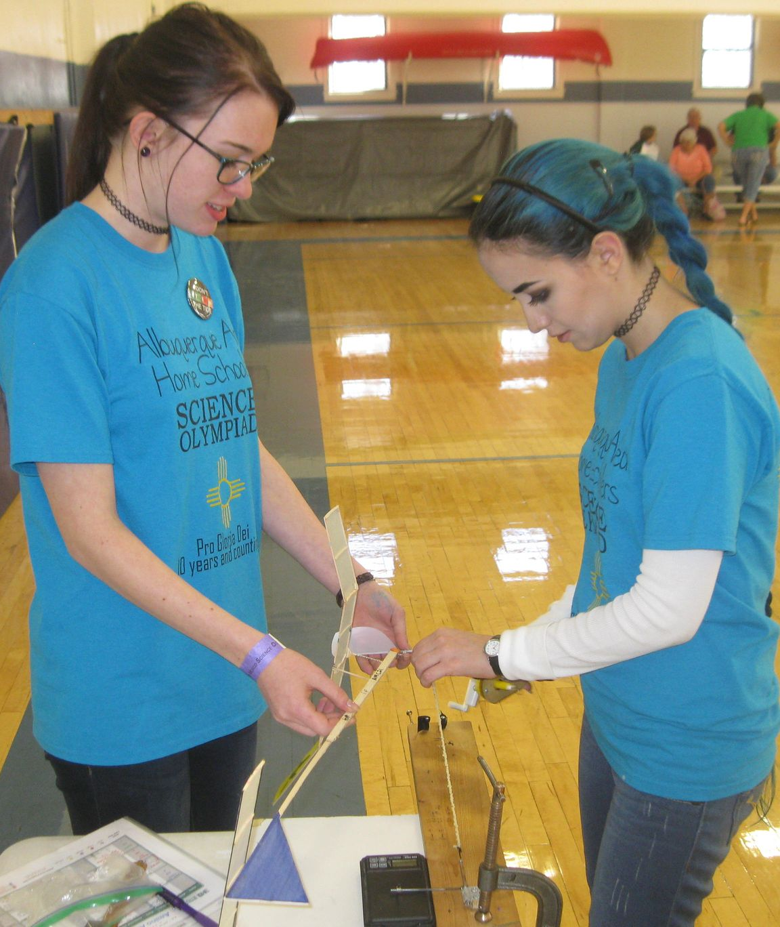
2024 Science Olympiad Flight Events
Slides by Chuck Andraka and Jeff Anderson
NFFS Education Committee

Slide 2
Presentation Order
Event descriptions and rules
Sources of materials and aid
Building techniques
Flying

Slide 3
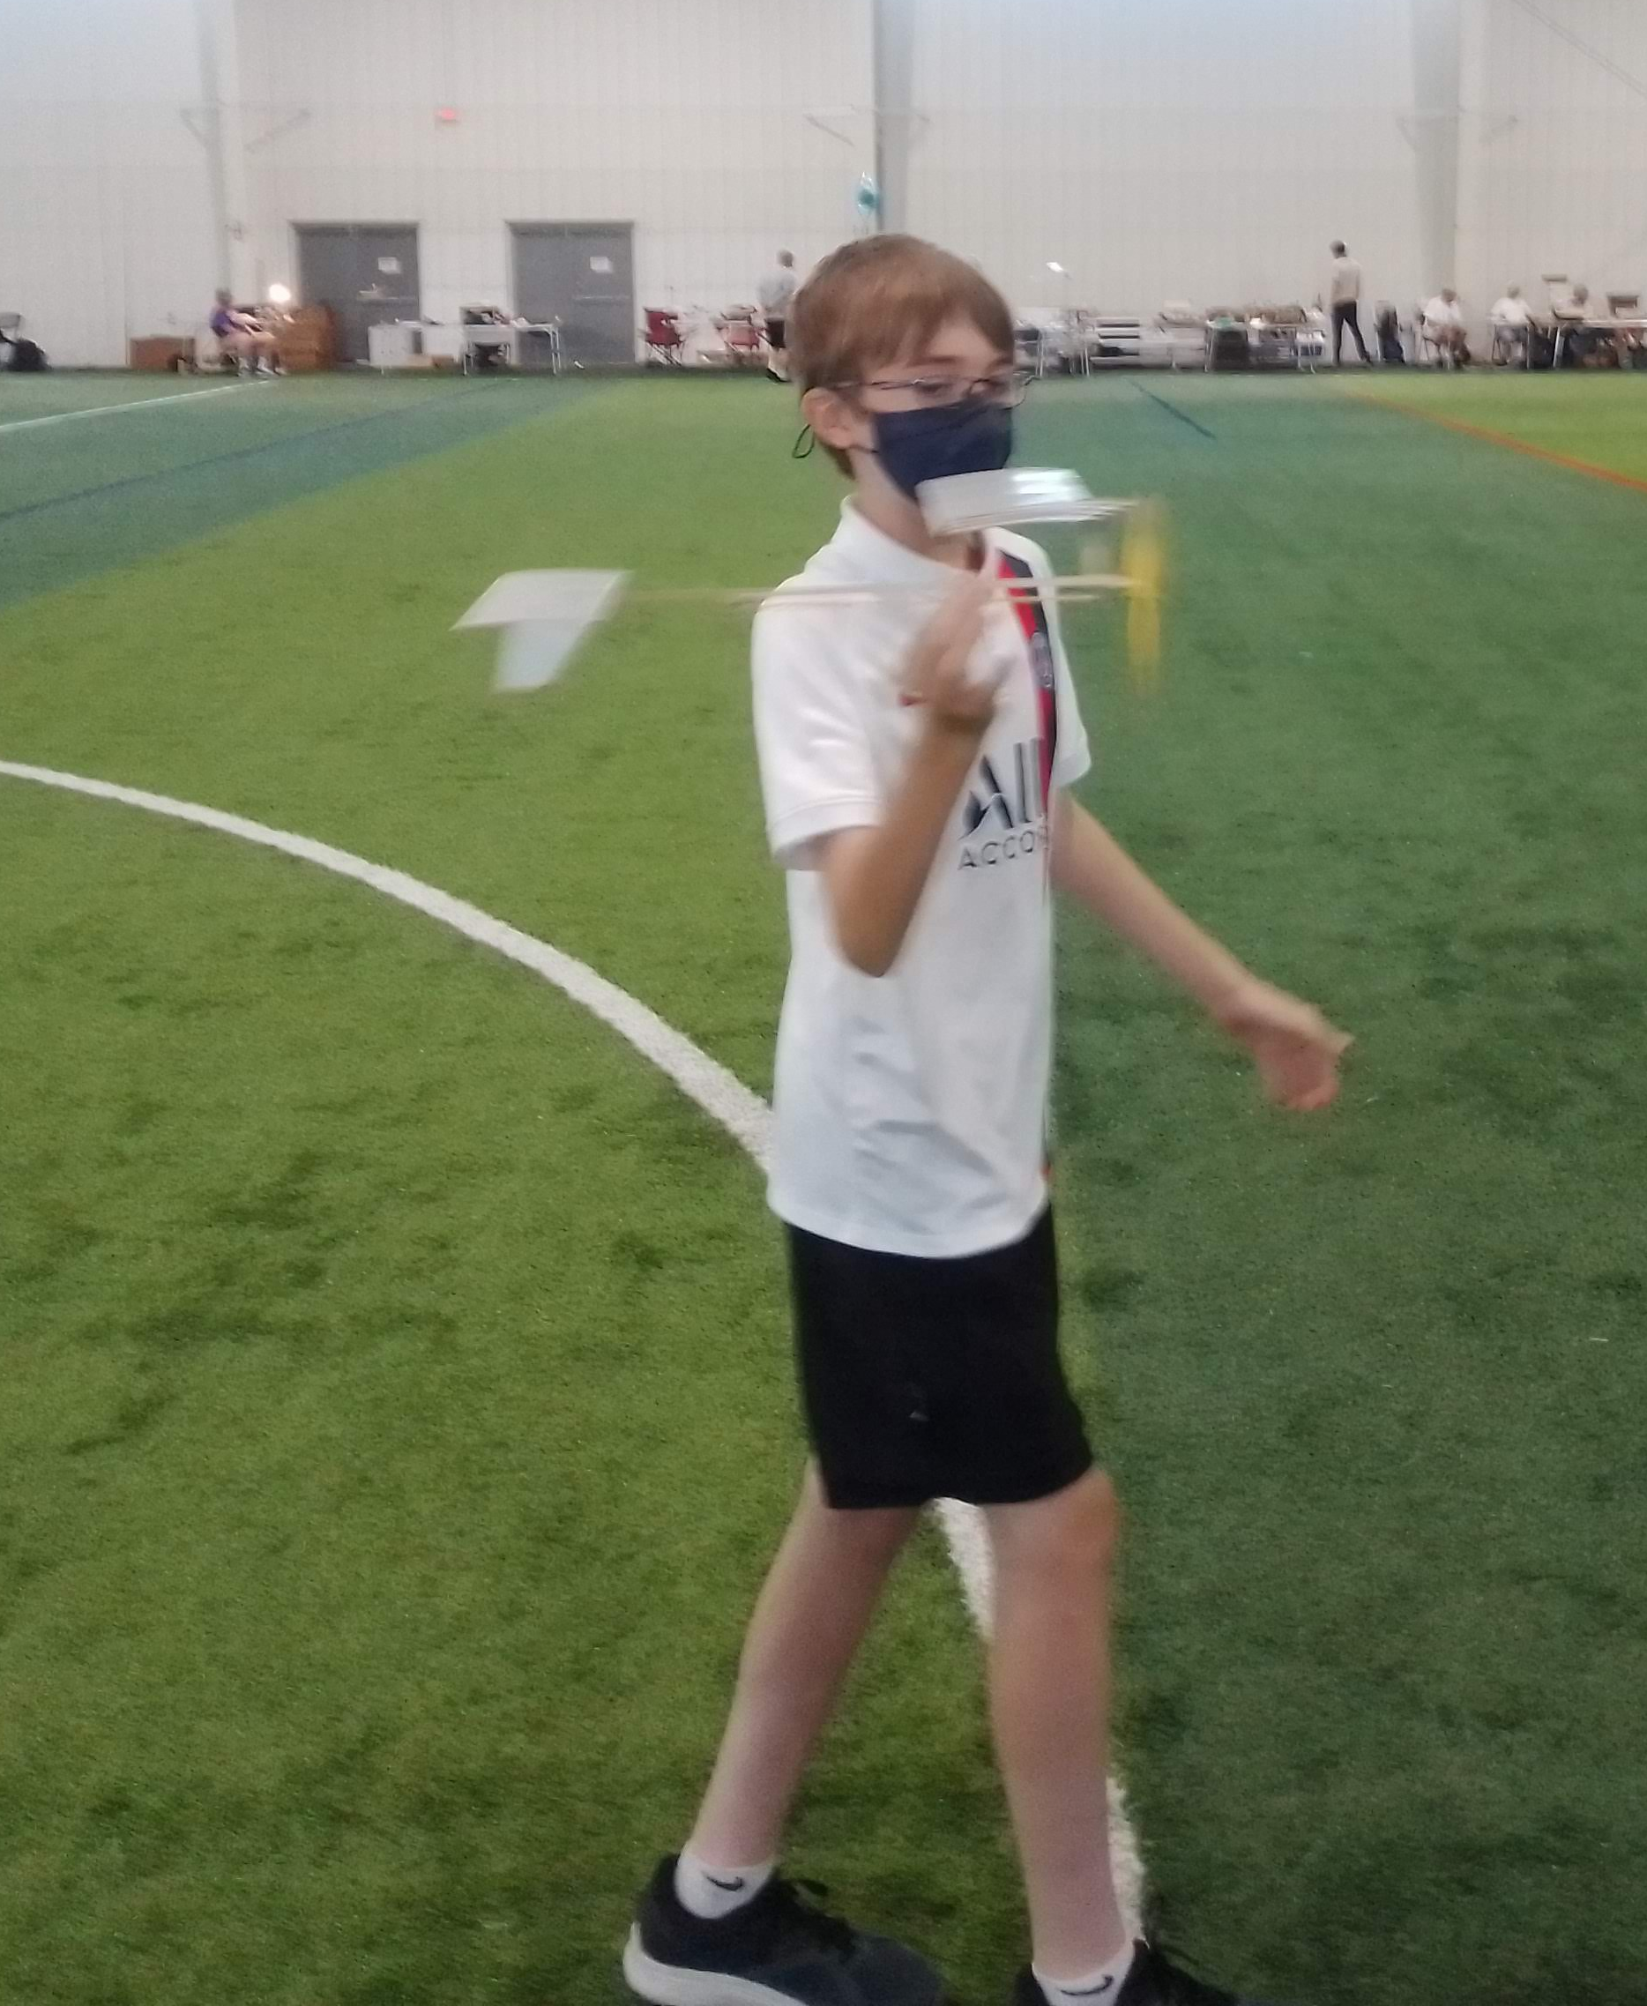
Flight (B&C)
Indoor Airplane Duration

Slide 4
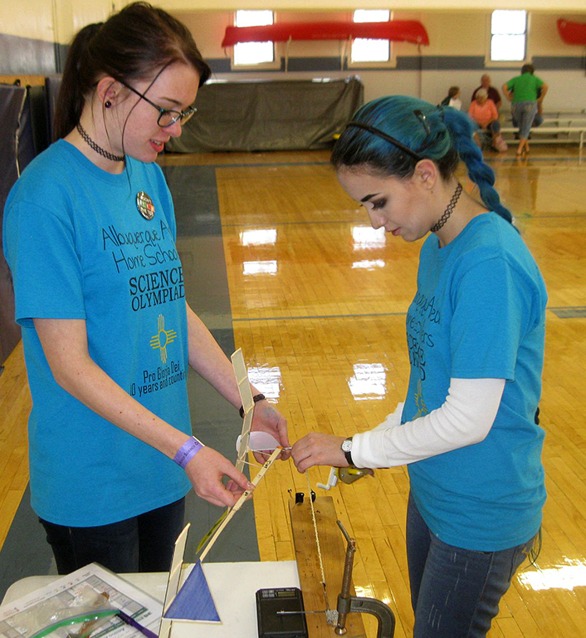
Flight Event Description
Prebuild event
Powered Indoor Aircraft flown for Duration
Made with any materials except Boron
Presented in a box with outer dimensions specified
Best of two flights duration
Kits are permitted
Student-Built

Slide 5
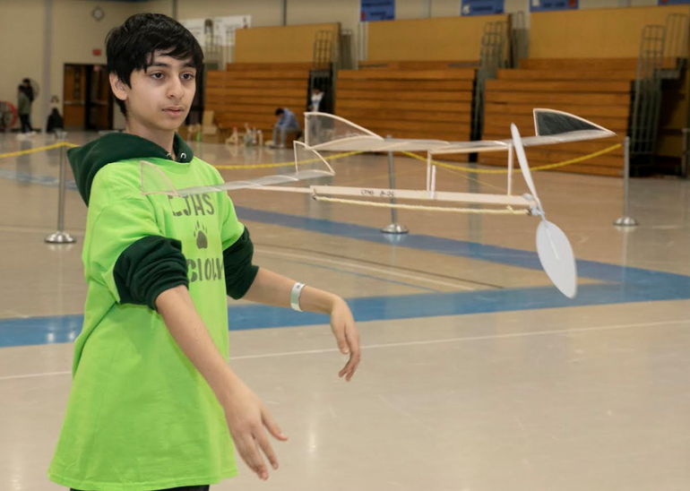
Flight Event Changes
Changes to box dimensions
Only one box must be presented
1.5g motors
No black marking bonus
No build log
No log cover sheets
Flight log now a bonus, not penalty

Slide 6
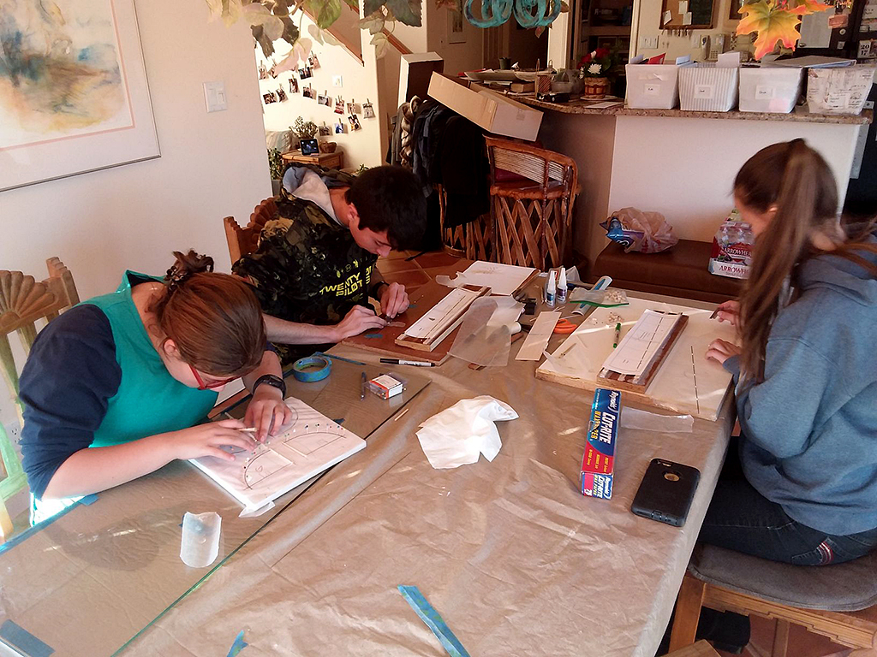
Flight Event Direction
NOT a design event, but a flight optimization event
Data collection and recording is critical to success
BUILD LIGHT, try to reach the minimum allowed weight
Build accurately. Crooked, twisted planes do not fly well
Take LOTS of data == Fly A Lot

Slide 7
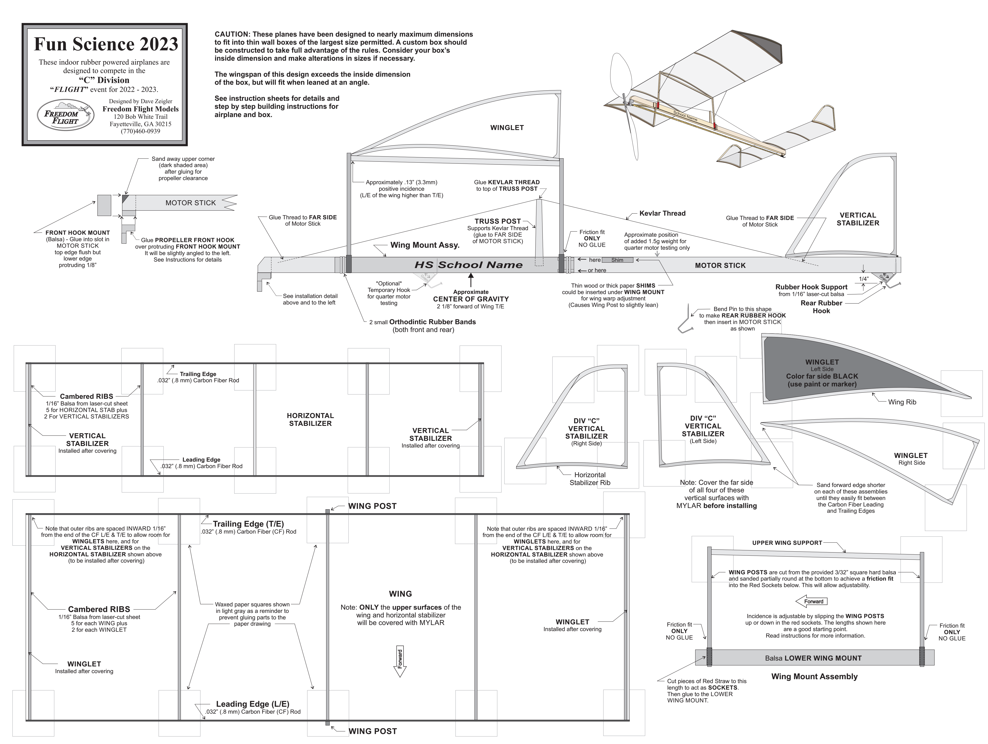
Event Parameters
Kit, plans, or self-design
  No pre-glued or pre-covered
Must fit in specified box ready to fly
  Team may buy or build a box
  Only 1 box required (“measurement box”)
  B: 41cm x 28.5cm x 65cm (long banker’s box)
  C: 32cm x 23cm x 47cm (8-ream paper box)
  Box cannot change shape of airplane!
  Team responsible to verify box dimensions
Do not push the dimensions. Too big and you will be tiered
Propeller built or purchased
Labelled for identification
Up to 2 planes presented for inspection
2-Student team
Non-compliant planes/boxes tiered

Slide 8
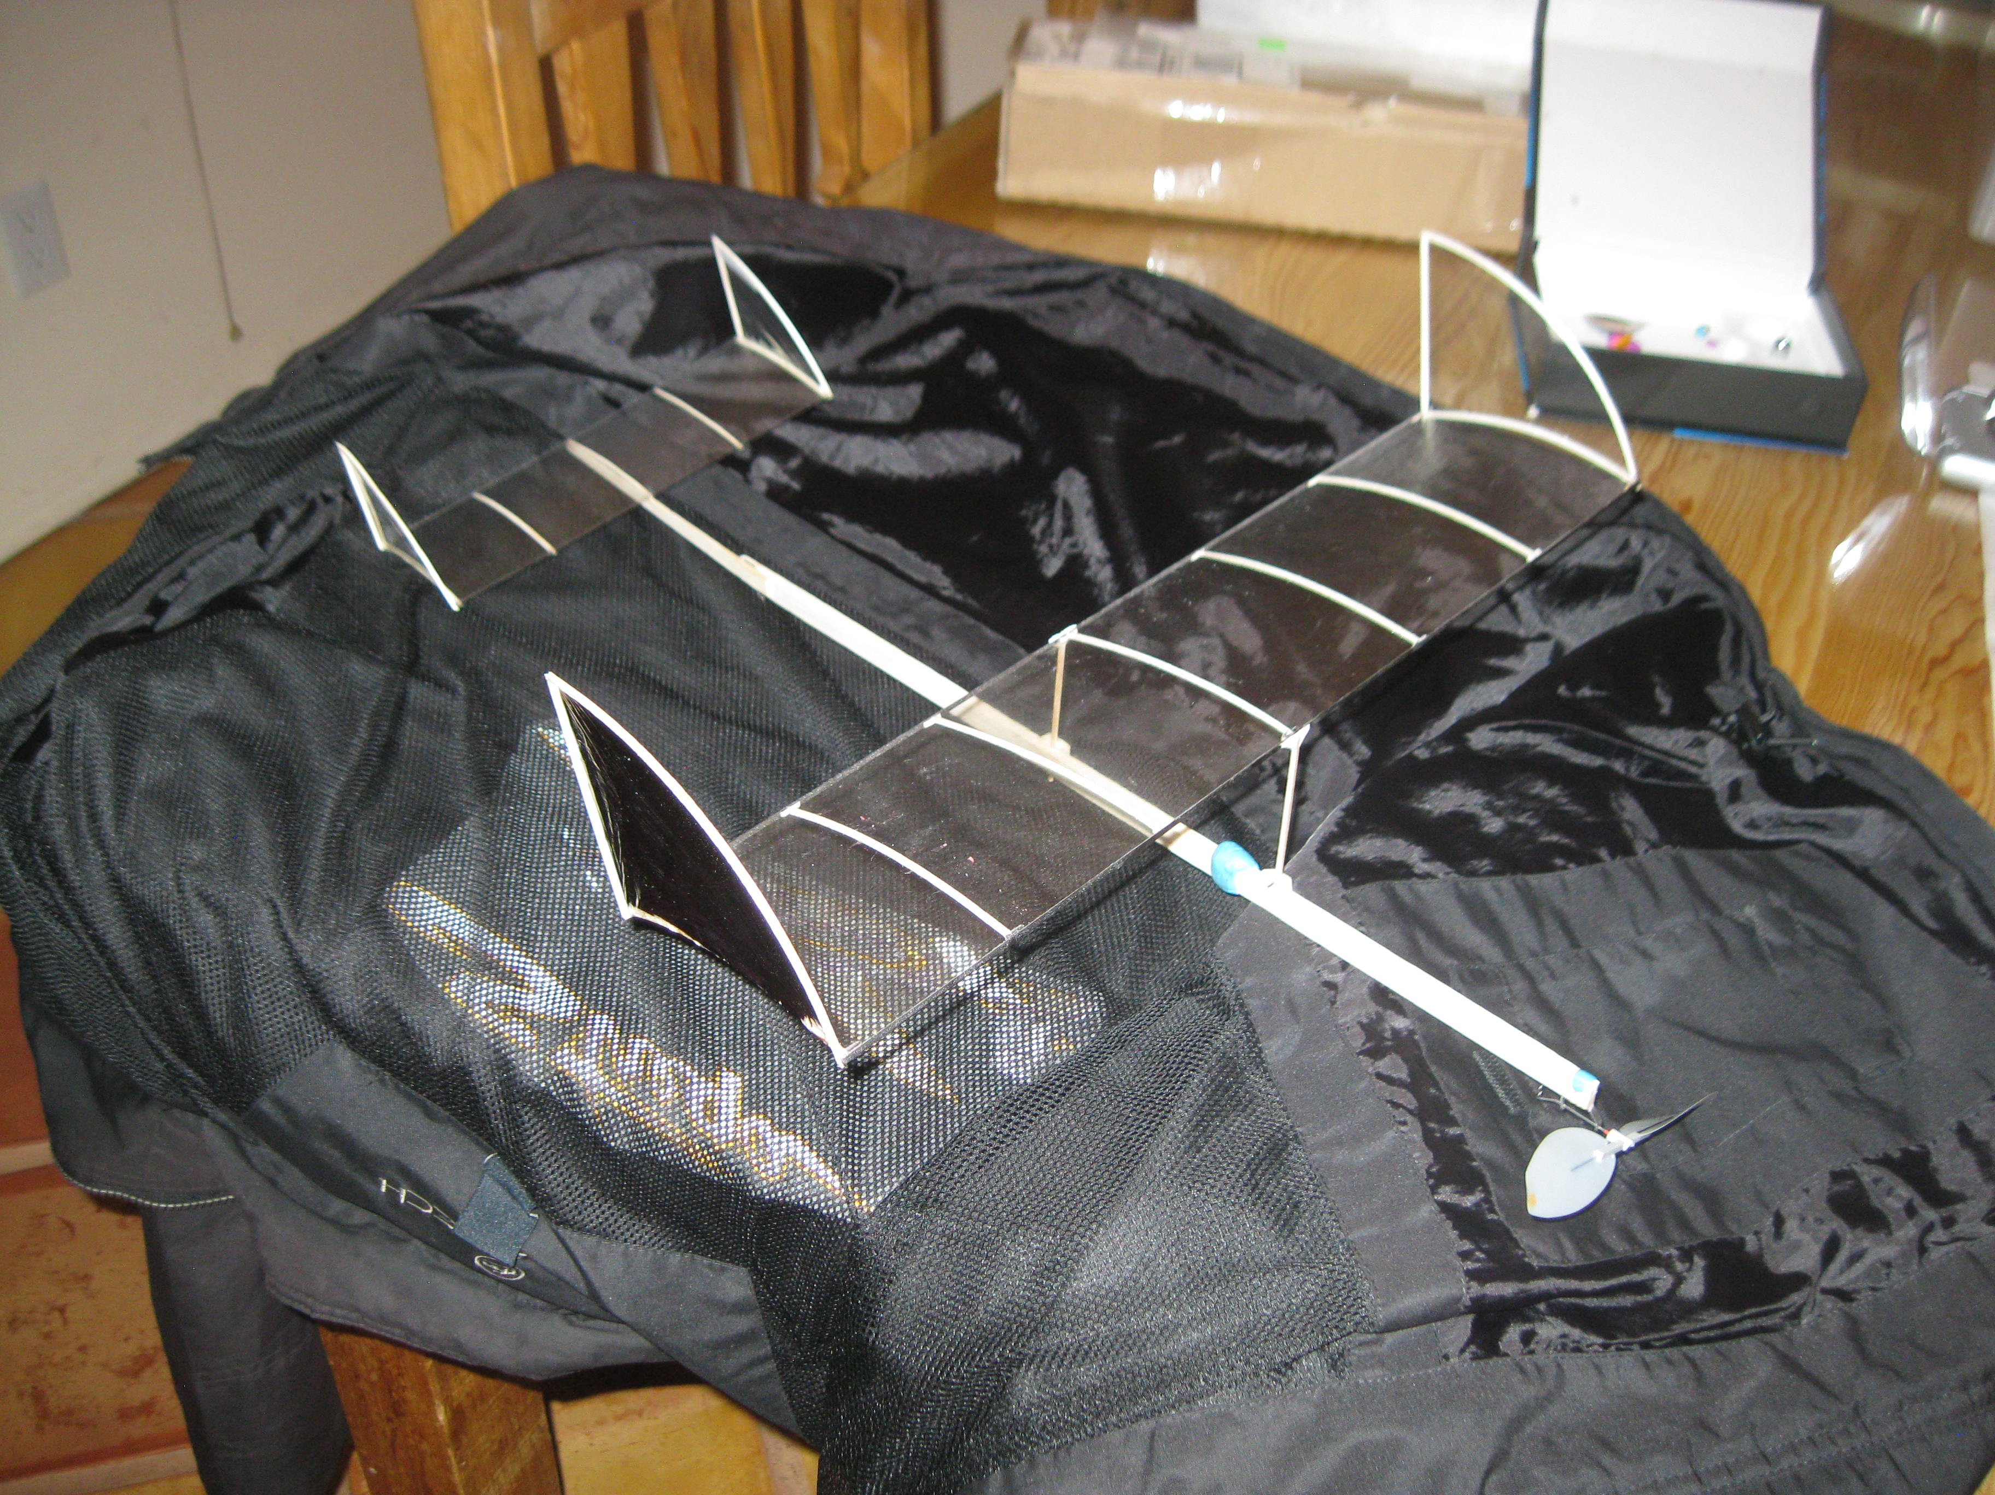
Additional Event Parameters
Propeller diameter not limited, but must be installed and fit in box
Propeller built or purchased
8g minimum without rubber
  Approx. 9.5g flying weight
Rubber powered
  1.5g maximum rubber mass
  Includes any o-rings
  Before or after lube
  6 rubber motors, or sets for multiple propeller planes may be processed

Slide 9
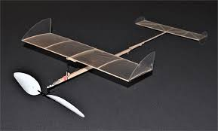
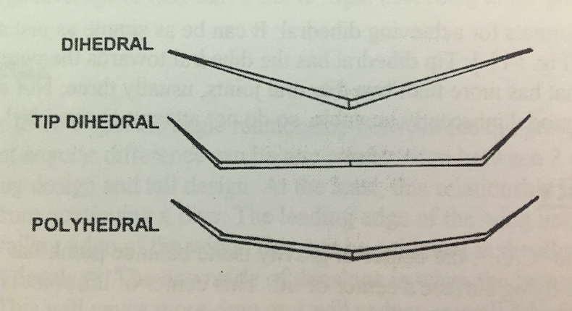
Flexibility of Design
Plane configuration
  Any wing configuration
    Monoplane
    Tandem
    Biplane
    Triplane
    Helicopter
    Glider
  Tractor vs. pusher
Which dimensions fit what part of box
  Think diagonal!
Format of wing (flat with tip plates, dihedral, polyhedral)
Tip plates in lieu of dihedral
Dihedral types

Slide 10
Flight Event
Flight Log
Complete log is 20% bonus
Incomplete 10% bonus
10 flights minimum
Required entries
  Motor size (length, width, mass)
  Number turns or torque AT LAUNCH
  Flight Time
Three additional minimum columns
  Altitude
  Torque
  Remaining turns or torque
  Unwinds
  Propeller details
  Any other
Log is critical to improving

Slide 11
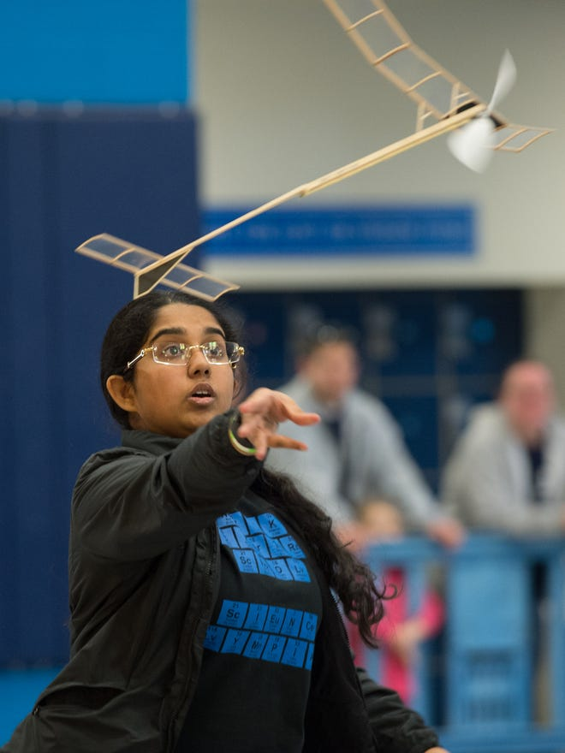
Event Flying Process
Indoors, with room dimensions published in advance
No coaching or communication once in competition area
ONLY PARTICIPANTS may touch plane and box. This means DO NOT let officials attempt to measure/weigh
Flight log: 20% bonus if complete, 10% if incomplete
Clock: A 10-minute flight clock when motor is given back to the team
  No time-out for retrieval or repairs
  A flight starting in 10-minute window may go to completion
Trim flights permitted during 10-minute competition window, but must be announced as trim
Score best duration of 2 official flights, plus bonuses
Construction violations are tiered

Slide 12
ES Experience Issues and Observations
Insufficient Logs
  Only 10 entries (or less)
  Too few columns
  Meaningless columns (eg: date)
  Logs are a critical element of improvement
Crooked construction
  Accurate construction is critical
Untrimmed models
Heavy models: Too much glue!
Most planes reasonably built, but not reasonably trimmed
  Need to do a circle for any reasonable duration
  Trim plane for low power, then work on higher power adjustments
Not flying the same in practice and competition
  Do not let observations of others change your approach!

Slide 13
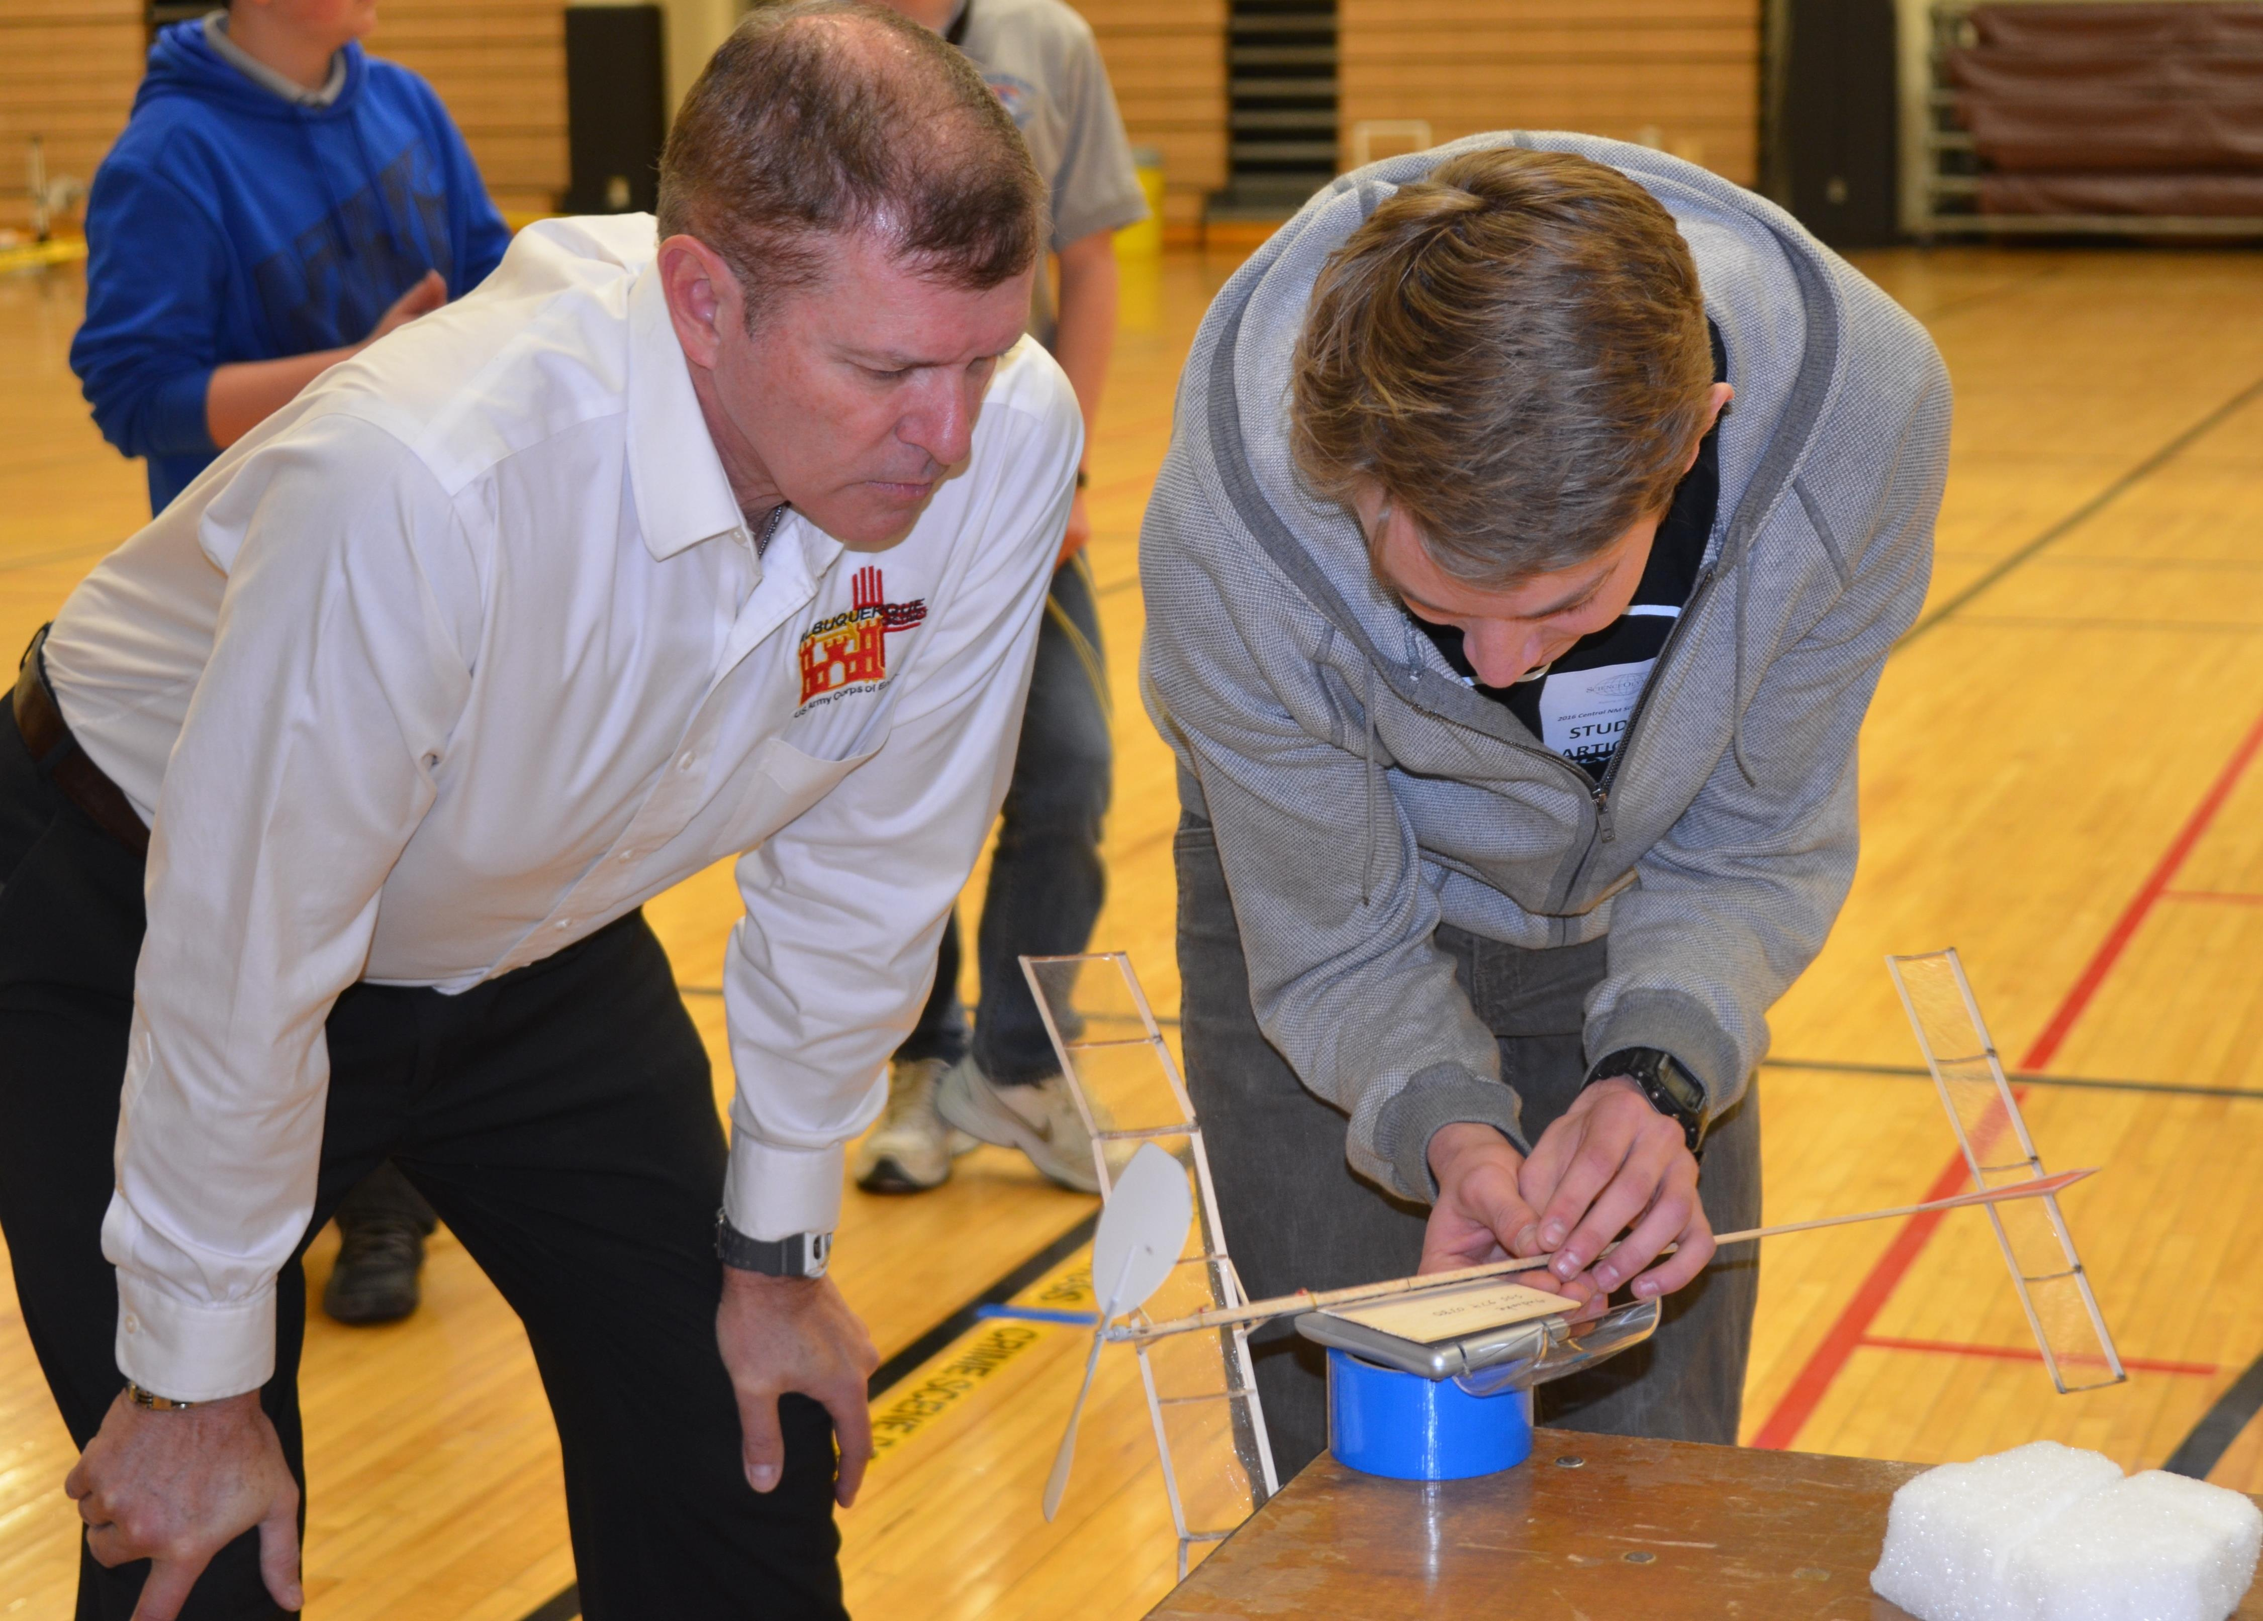
Thoughts for improvement
Box dimensions (C Div) make short tail moment, challenging to trim
Spend more time in gym than in build
Keep detailed logs
Read and follow rules carefully
Use resources, especially the online forum at Scioly
NFFS continues to develop resources and videos

Slide 14
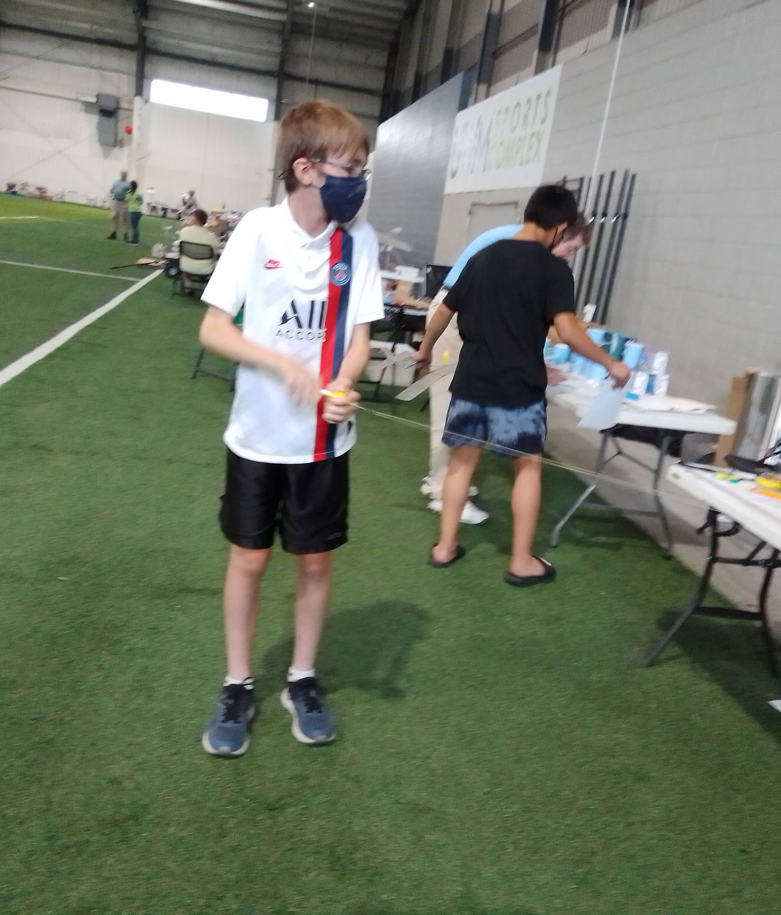
Sources
Kits
Supplies
Help

Slide 15
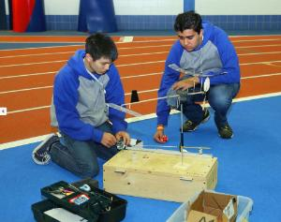
Kits
Ward’s Science
  Official Science Olympiad Supplier
  “Kit” includes tools, glues, etc. to get you started
  Generally more “Open Ended” than other kits
    Less direct design and guidance
    Not as refined

Slide 16
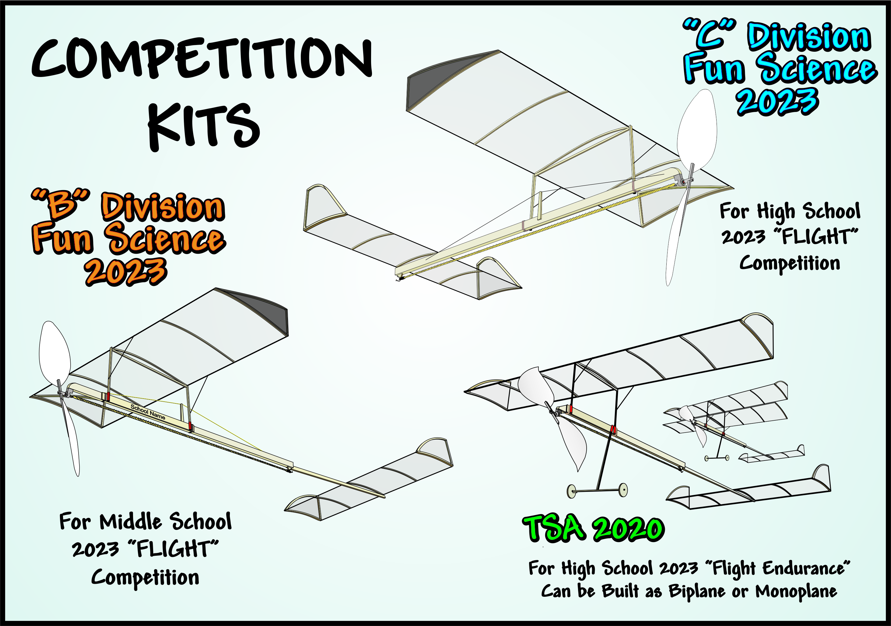
Kits
Freedom Flight Models
  Complex but competitive, consistently in top 10 at Nationals
  Consistent quality
  EXTENSIVE instructions
  https://www.freedomflightmodels.com
Also a full stock of accessories
  Torque meter
  Winder
  Counter
  Rubber
  Propellers

Slide 17
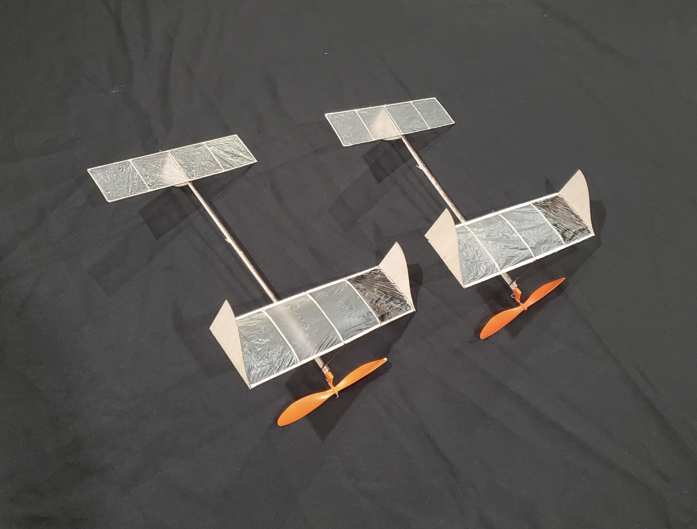
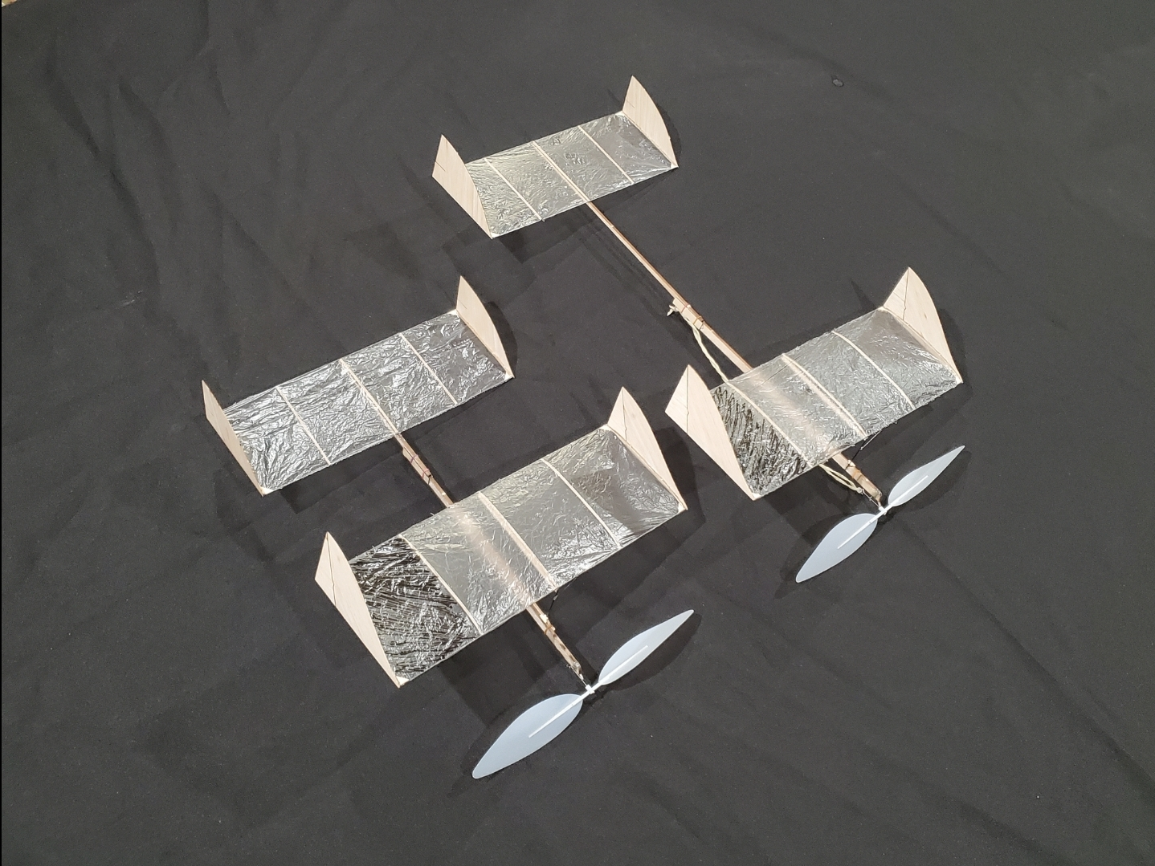
Kits
J&H Aerospace
  Competitive indoor flyer designs
  Generally Josh kits two planes, entry level and advanced
    Senior Flyer is simpler, easier to trim
    Stinger has carbon, more wing, advanced trimming
  Many good YouTube videos
  https://jhaerospace.com/

Slide 18
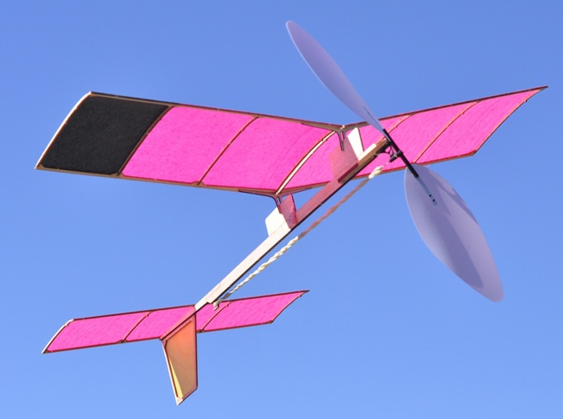
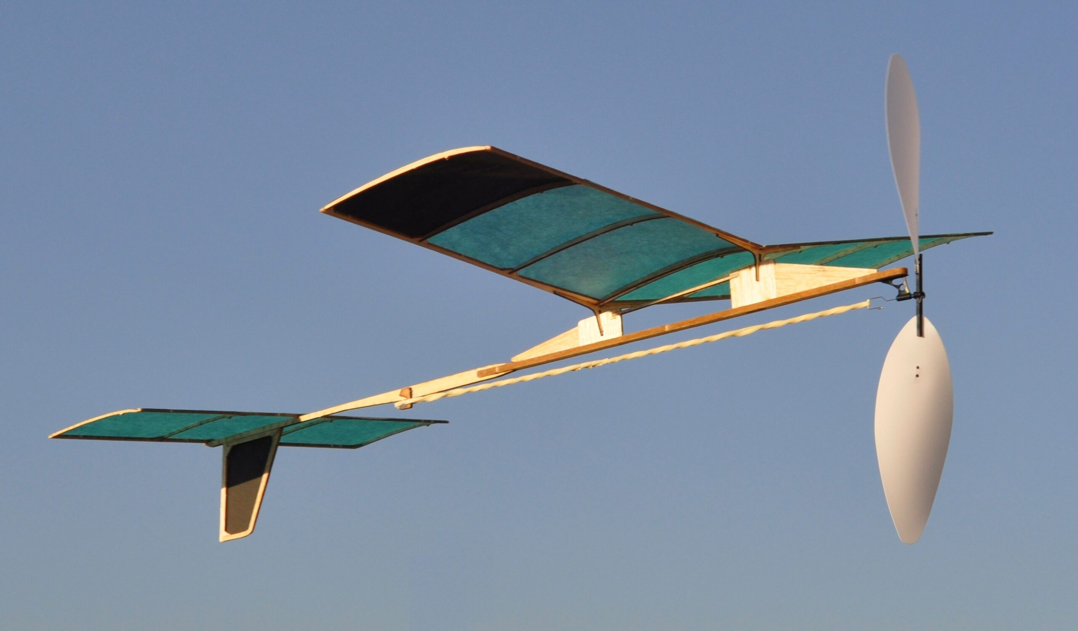
Kits
Laser Cut Planes
  Simple building
  Good flying design
  Low cost
  Photo-instructions, no plans
  https://lasercutplanes.com/
  Known for simple assembly
  Two Designs for B and C

Slide 19
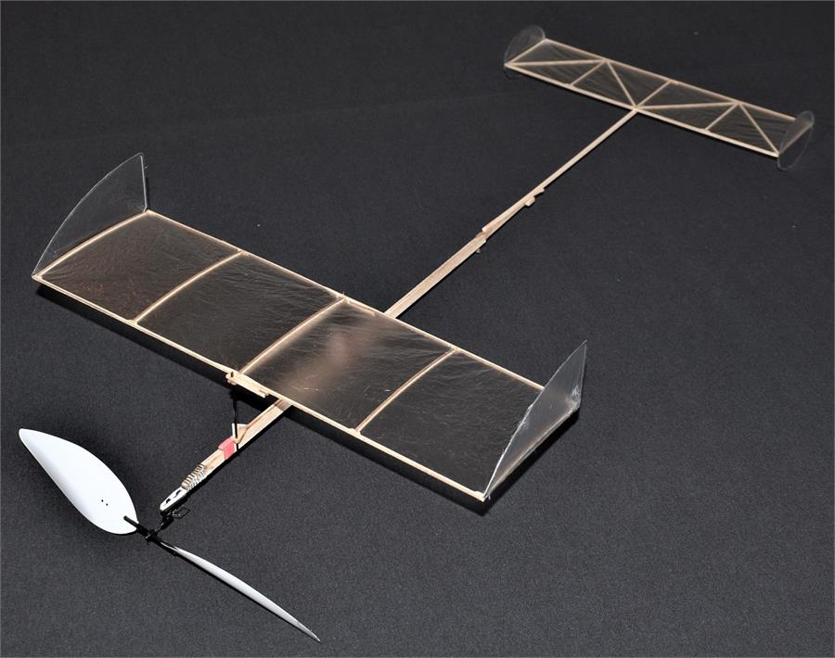
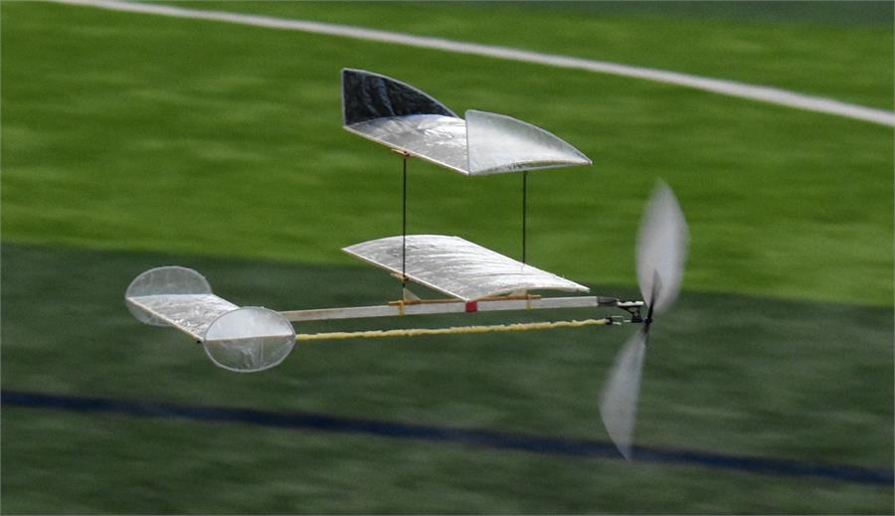
Kits
Retro R/C
  Complete line of kits and parts
  Low prices, around $50 for two kit package
  Prop kits available
  Unique biplane option
  http://retrorc.us.com/scholastickitsandaccessories.aspx

Slide 20
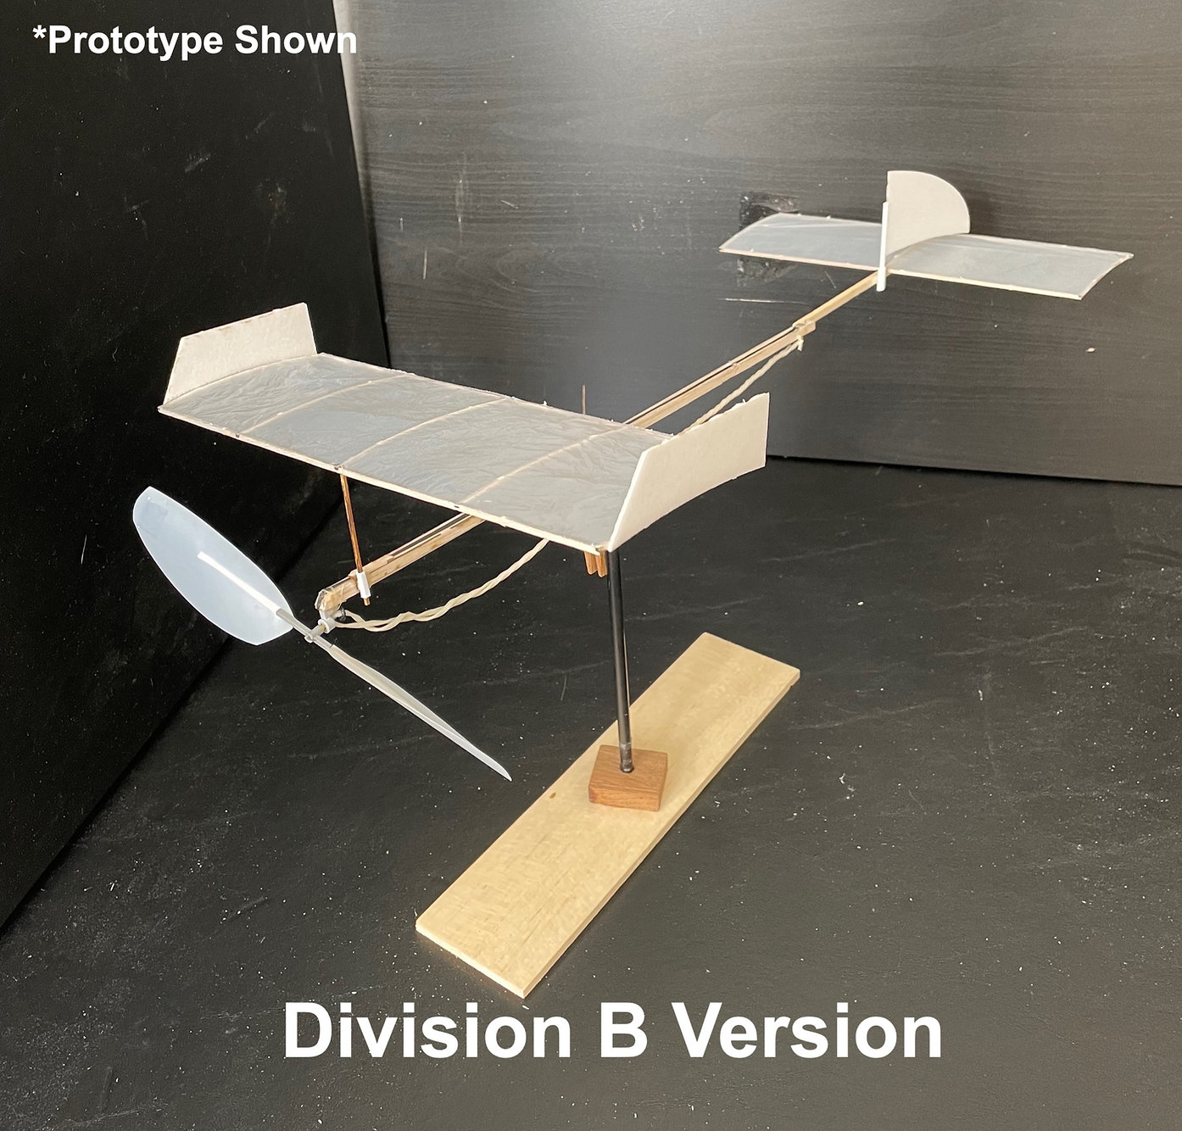
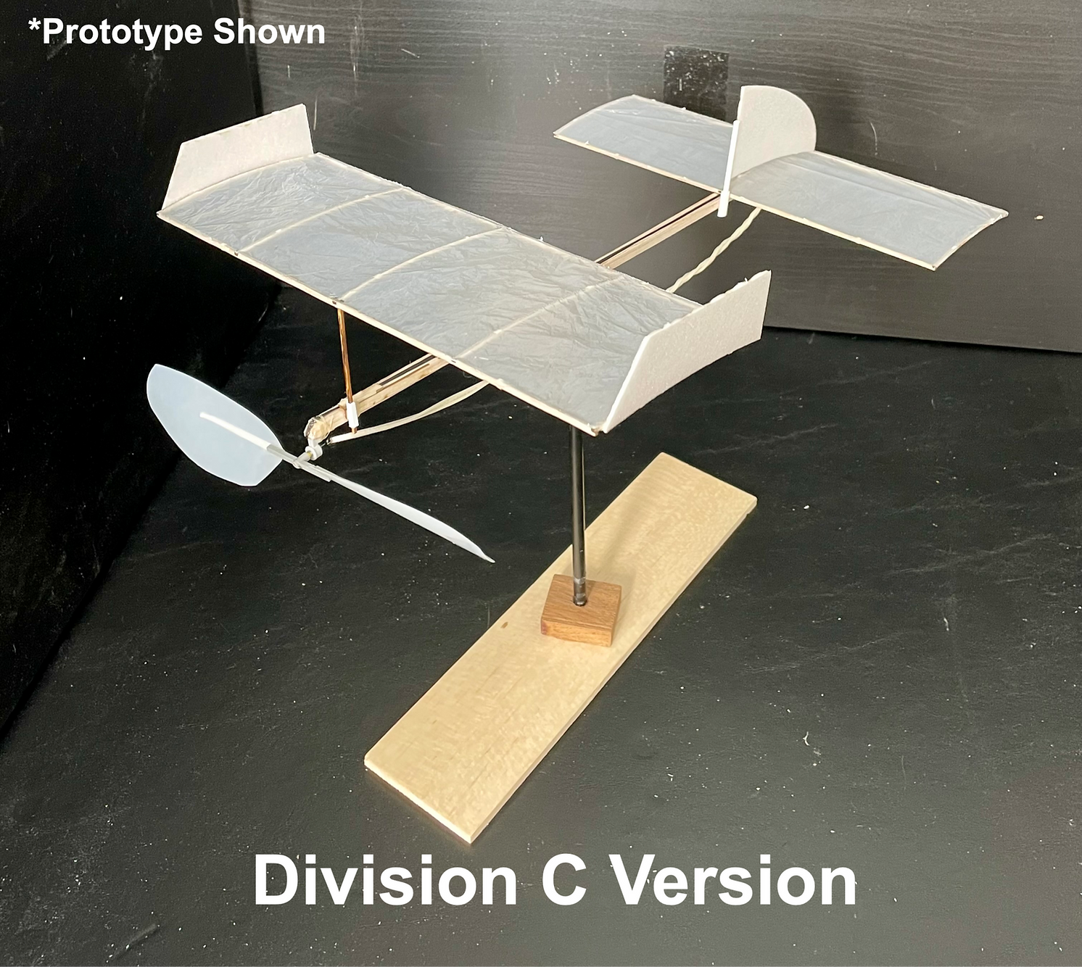
Kits
Guru Engineering
  Based out of WV, supported WS win at Nationals 6 years ago
  Non-profit
  Low cost options
  http://main.guruengineeringtech.com/

Slide 21
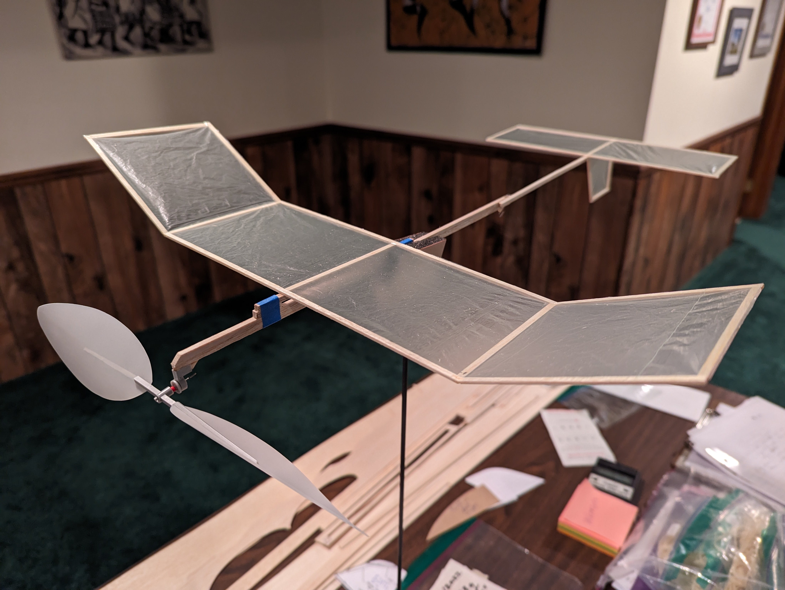
Plans
NFFS Super Simple plane
  https://www.youtube.com/watch?v=Mbxba3g1hMU
  Craft store supplies
  Stock prop
  2-minute flights
  Builds in less than 1 hour
Bill Gowen Finny
  https://www.hippocketaeronautics.com/hpa_plans/index.php
  Search for Finny
  Annual design, may need to update yourself
  Carbon spar construction

Slide 22
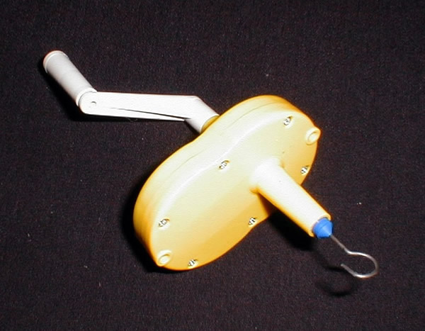
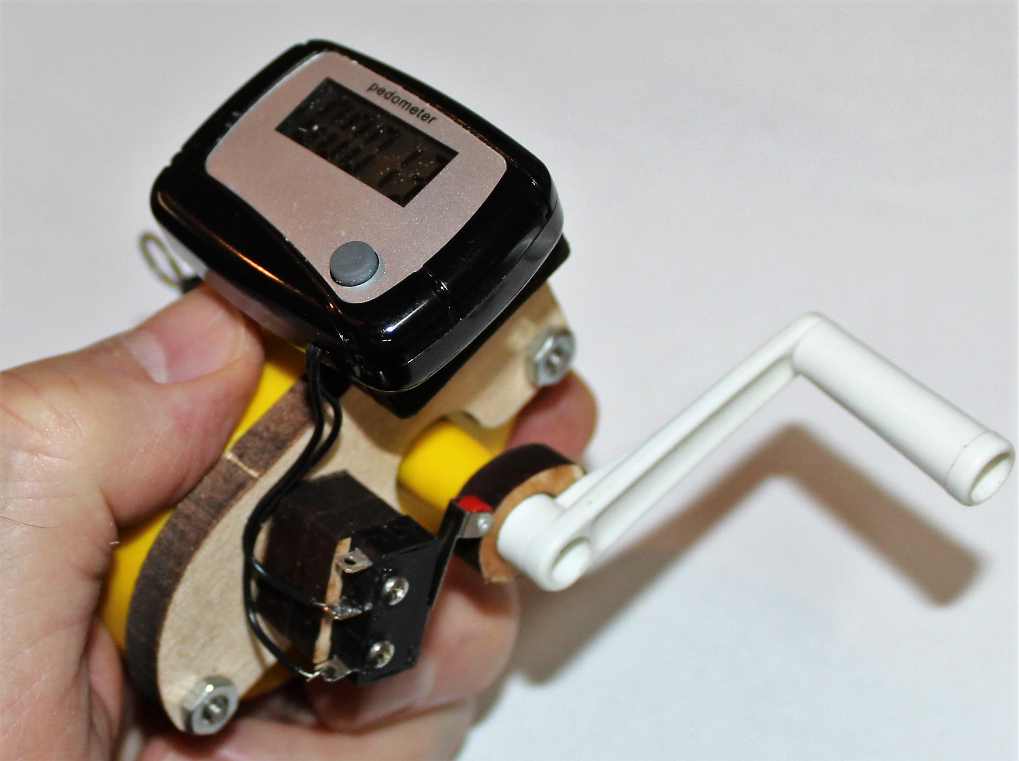
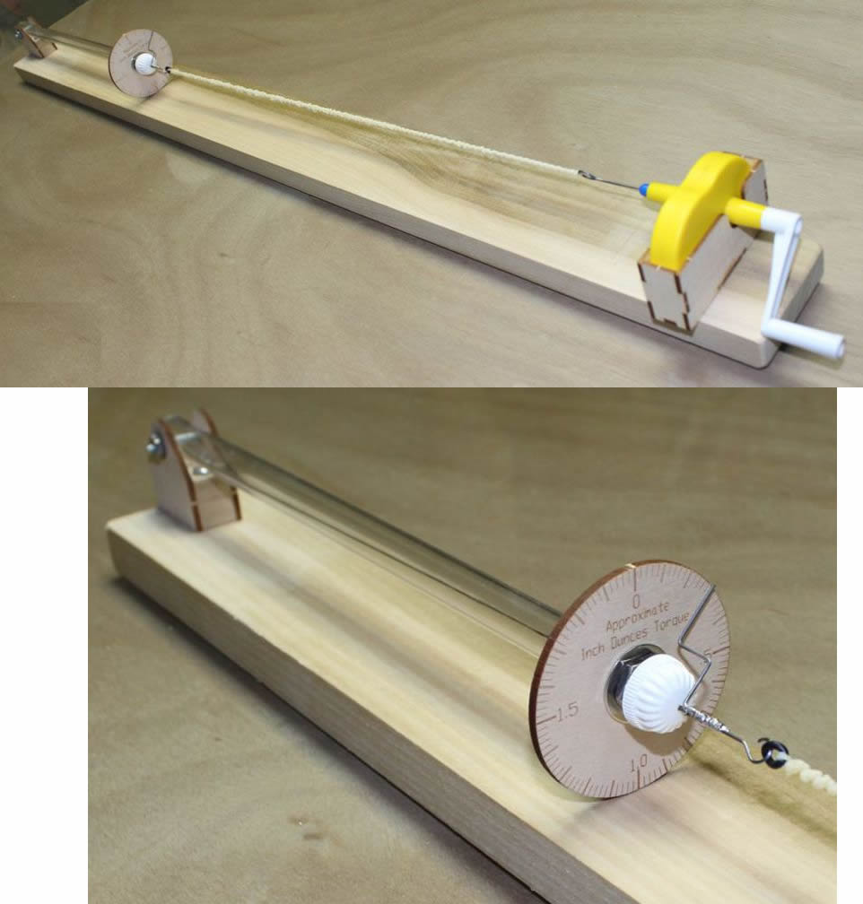
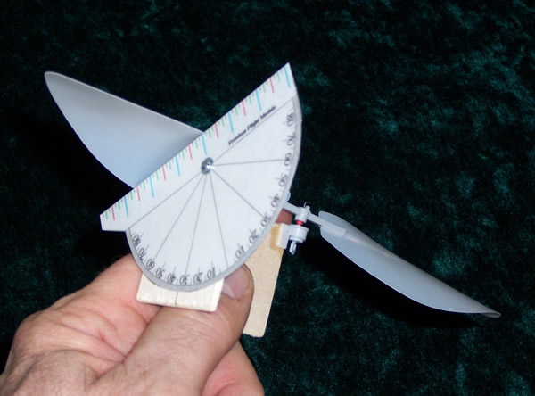
Accessories
Rubber, Props, Winders, Torque meters, covering
  Indoor Free Flight Supply
    https://www.indoorffsupply.com/
  Freedom Flight Models
    https://www.freedomflightmodels.com
  FAI Model Supply
    https://www.faimodelsupply.com/
  J&H Aerospace
    https://jhaerospace.com/
  Retro R/C
    http://retrorc.us.com/scholastickitsandaccessories.aspx
  Volare Products
    https://volareproducts.com/wordpress/
Covering, prop hangers, rubber stripper
  Indoor Model Specialties
    http://www.indoorspecialties.com/

Slide 23
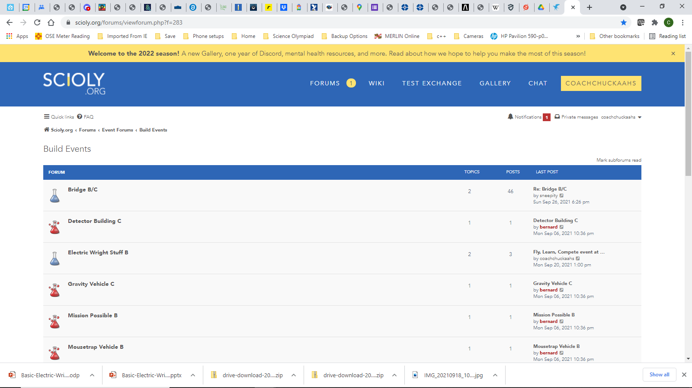
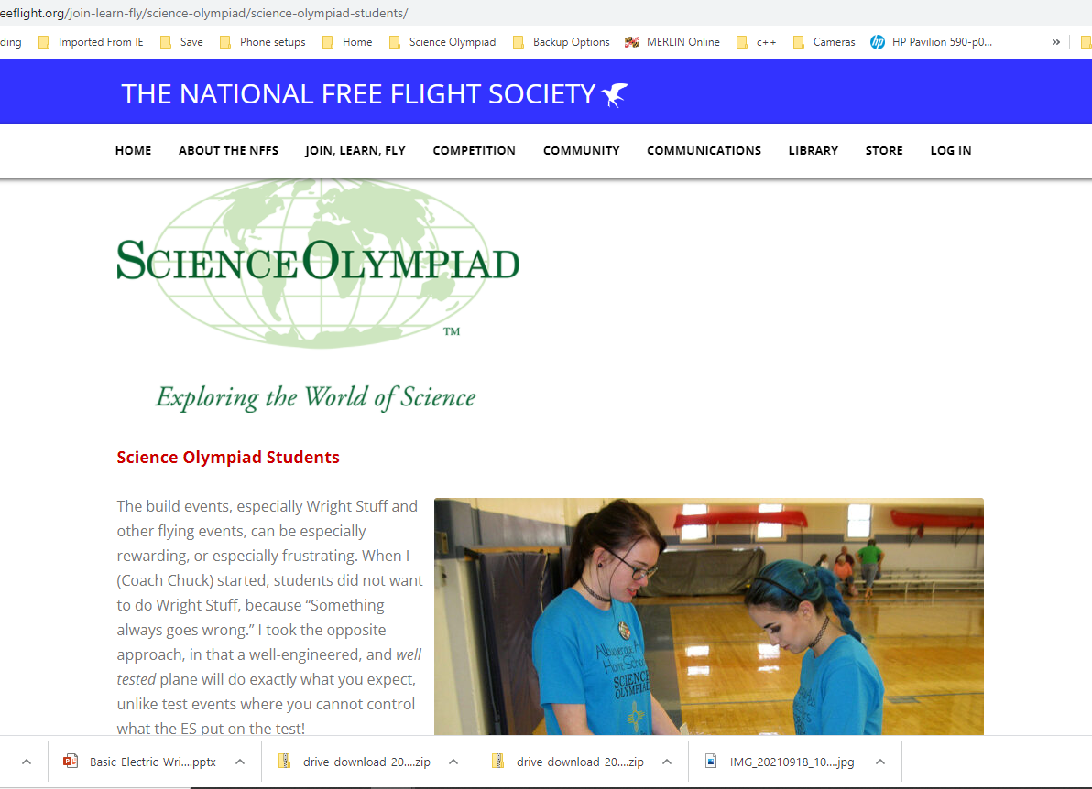
Resources and help
Plans
  Hip Pocket Aeronautics at http://www.hippocketaeronautics.com
  National Free Flight Society at https://freeflight.org/join-learn-fly/science-olympiad/
Online Resources
  National Free Flight Society at https://freeflight.org/join-learn-fly/science-olympiad/ includes videos, plans, how-to guides, etc.
  SCIOLY online forums at https://scioly.org/forums/viewforum.php?f=283
  Hip Pocket Aeronautics forums https://www.hippocketaeronautics.com/hpa_forum/index.php?board=33.0
  Minimizing weight gain: https://www.soinc.org/sites/default/files/uploaded_files/glueweight.pdf
  Basic Building: https://www.soinc.org/sites/default/files/uploaded_files/ScienceOlympiad5.0.pdf

Slide 24
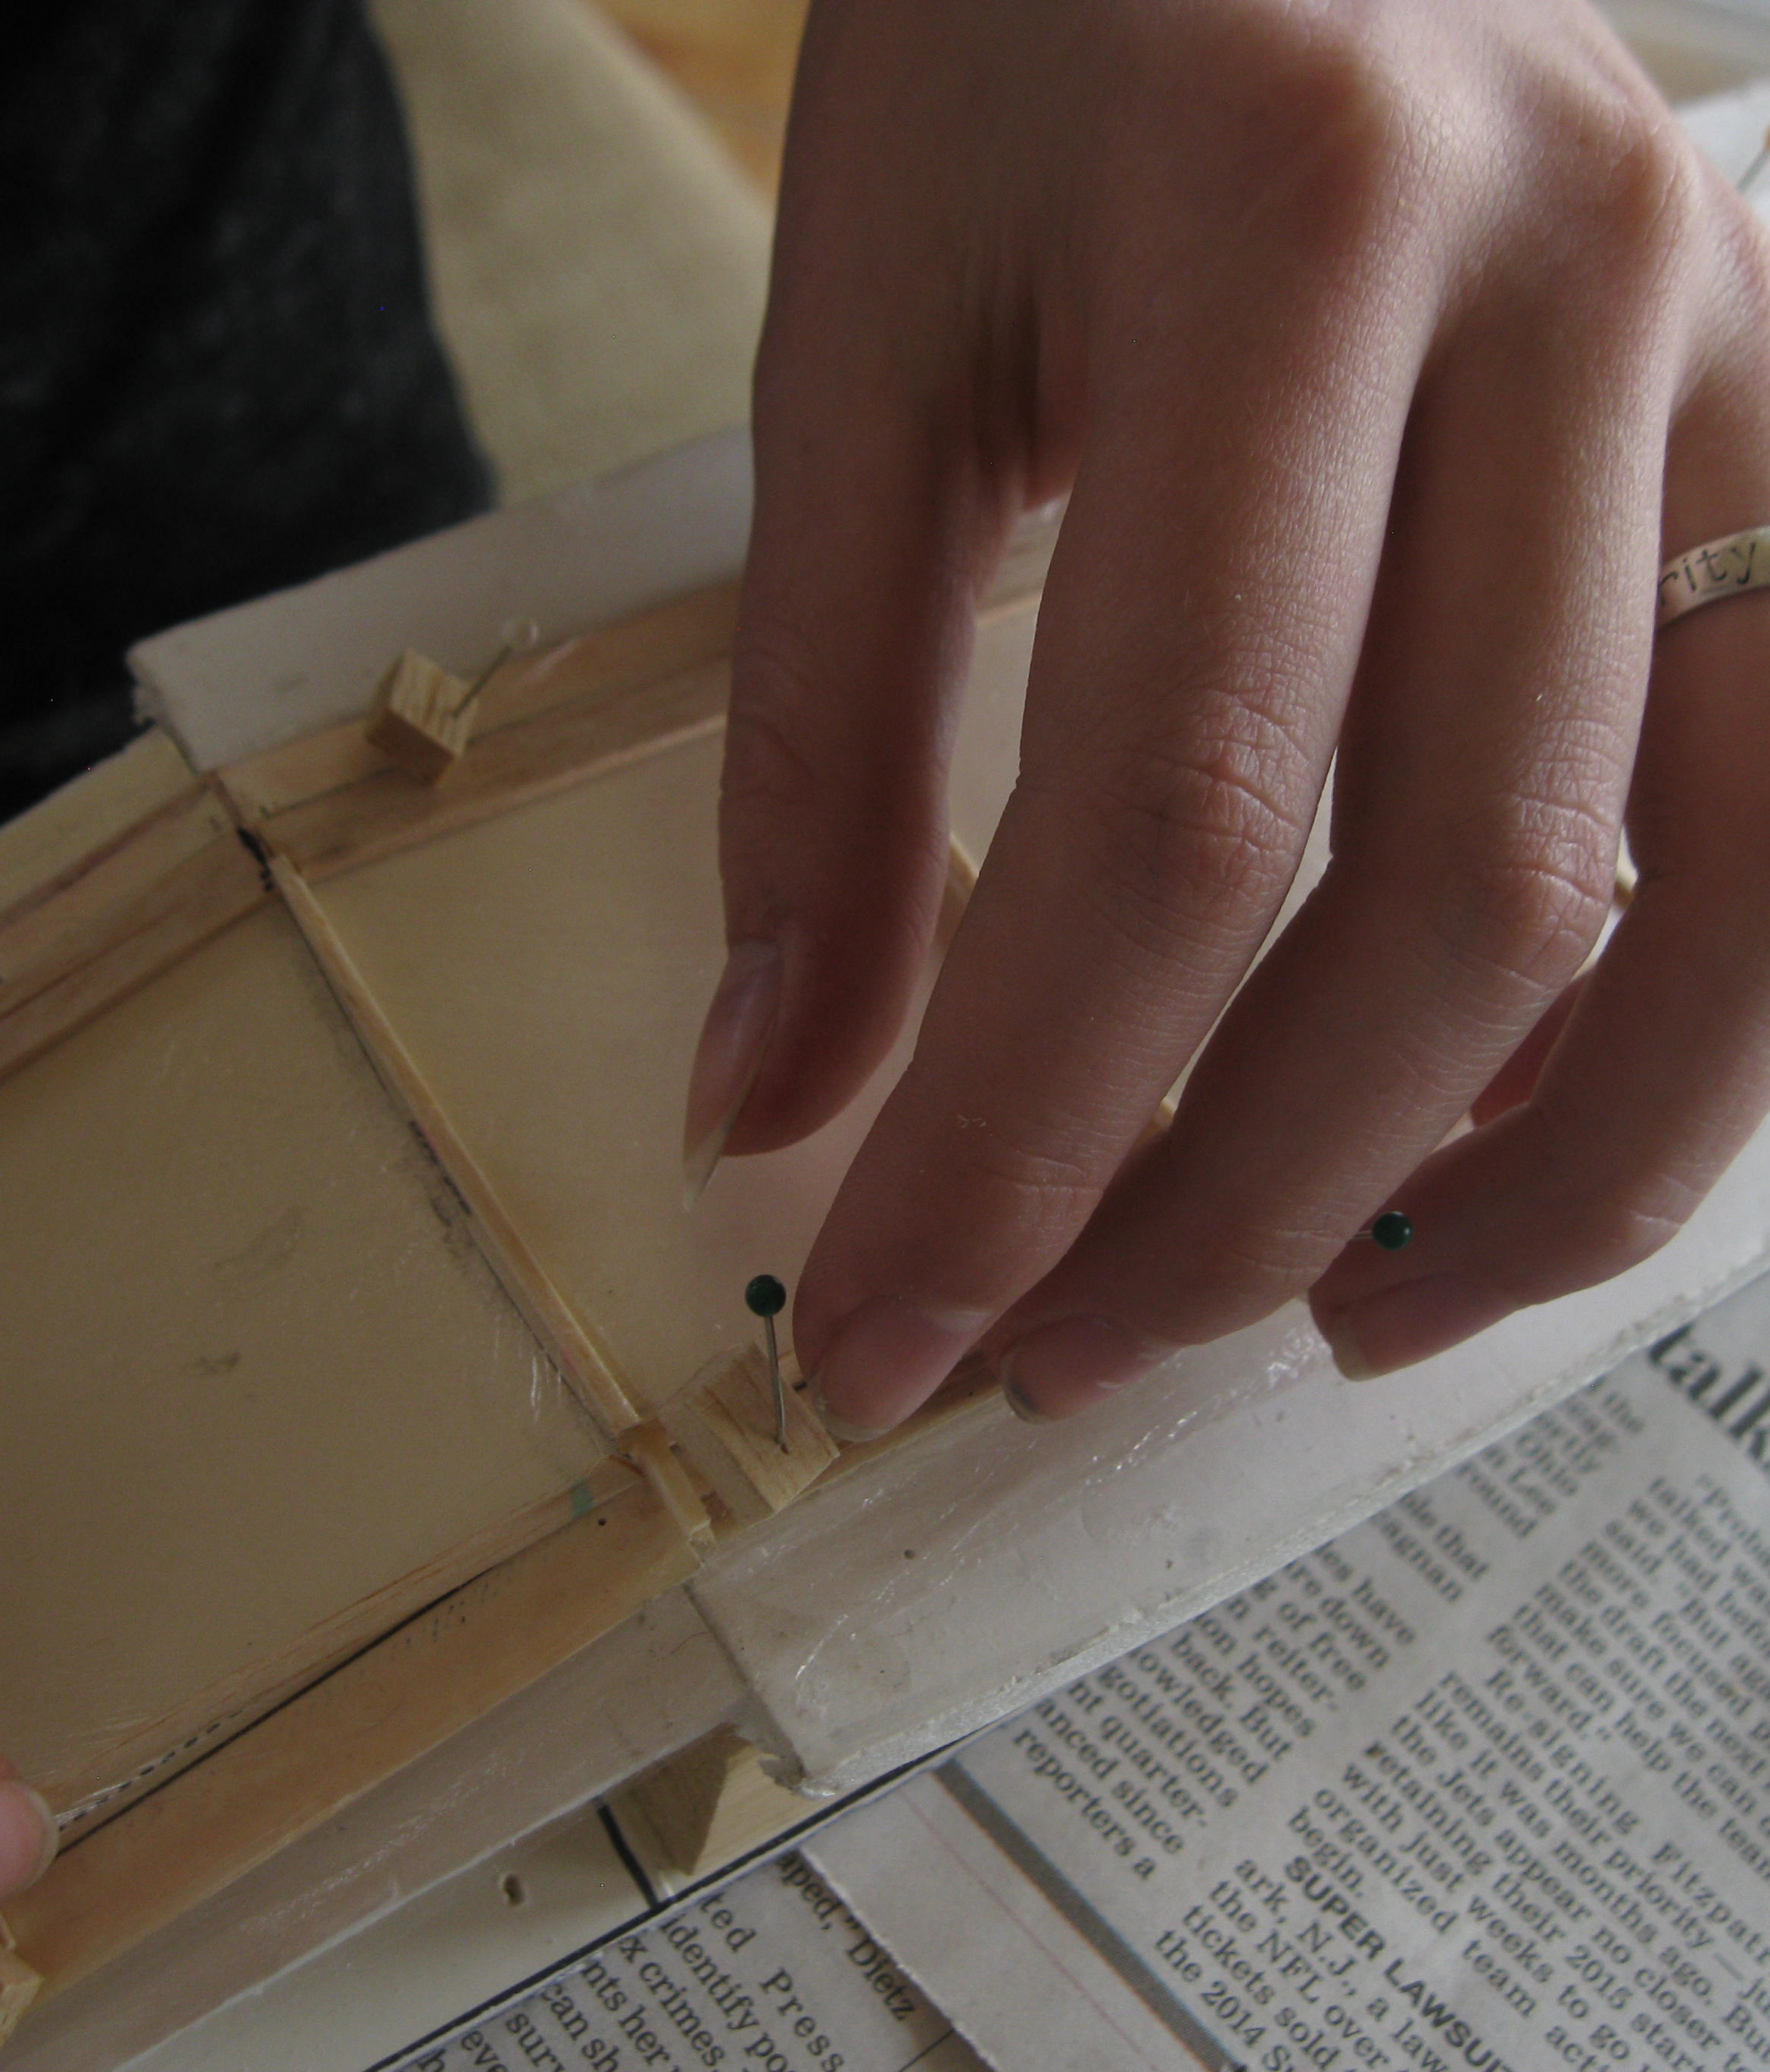
Building Techniques
Part 2 of Coach’s Clinic

Slide 25
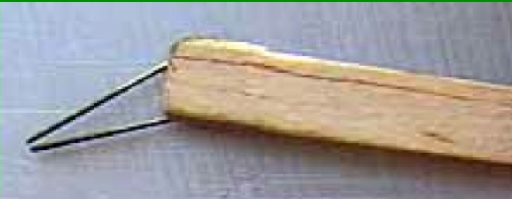
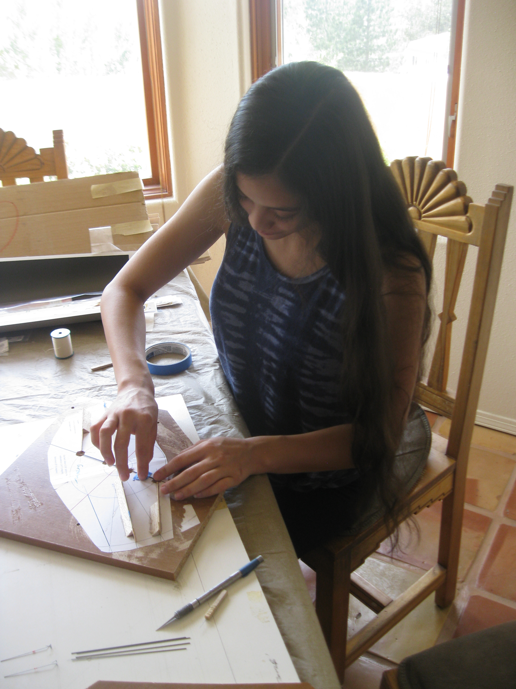
Building
Weight is EVERYTHING
  Glue control
    Thin CyA
    Capillary applicator
  Balsa Density
    Weigh and grade balsa
    Bring scale to store
    5-8 lb/cu ft is “contest grade”
    Heavier wood may be used, generous weight budget
    Kits have excellent wood
Straight
  Use fixtures
    Foam board allows pins
  Glass or shelving surface
Strength
  Wrap key joints with thread, dot of CA
  Carbon is light, stiff

Slide 26
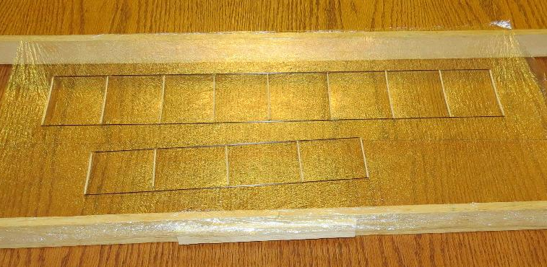
Covering
Ultrafilm is used in most kits
  Grocery veggie bags an excellent alternative
Prepare
  Build structure
  Build a frame scrap balsa
Film
  Cut with solder iron if available, tears easily
  Ball up as small as possible, twice
  Unfurl with outward stretching motion
  Attach to frame with lip balm or Vaseline
  Carefully stretch to edges, not tight
Adhesive
  3M 77 is best (easy, light enough)
    Glue stick an alternative
  Light coating on top of structure separate from covering
  Press into framed film inverted
  Allow to cure
  Cut with soldering iron
    Careful not to dwell on carbon

Slide 27
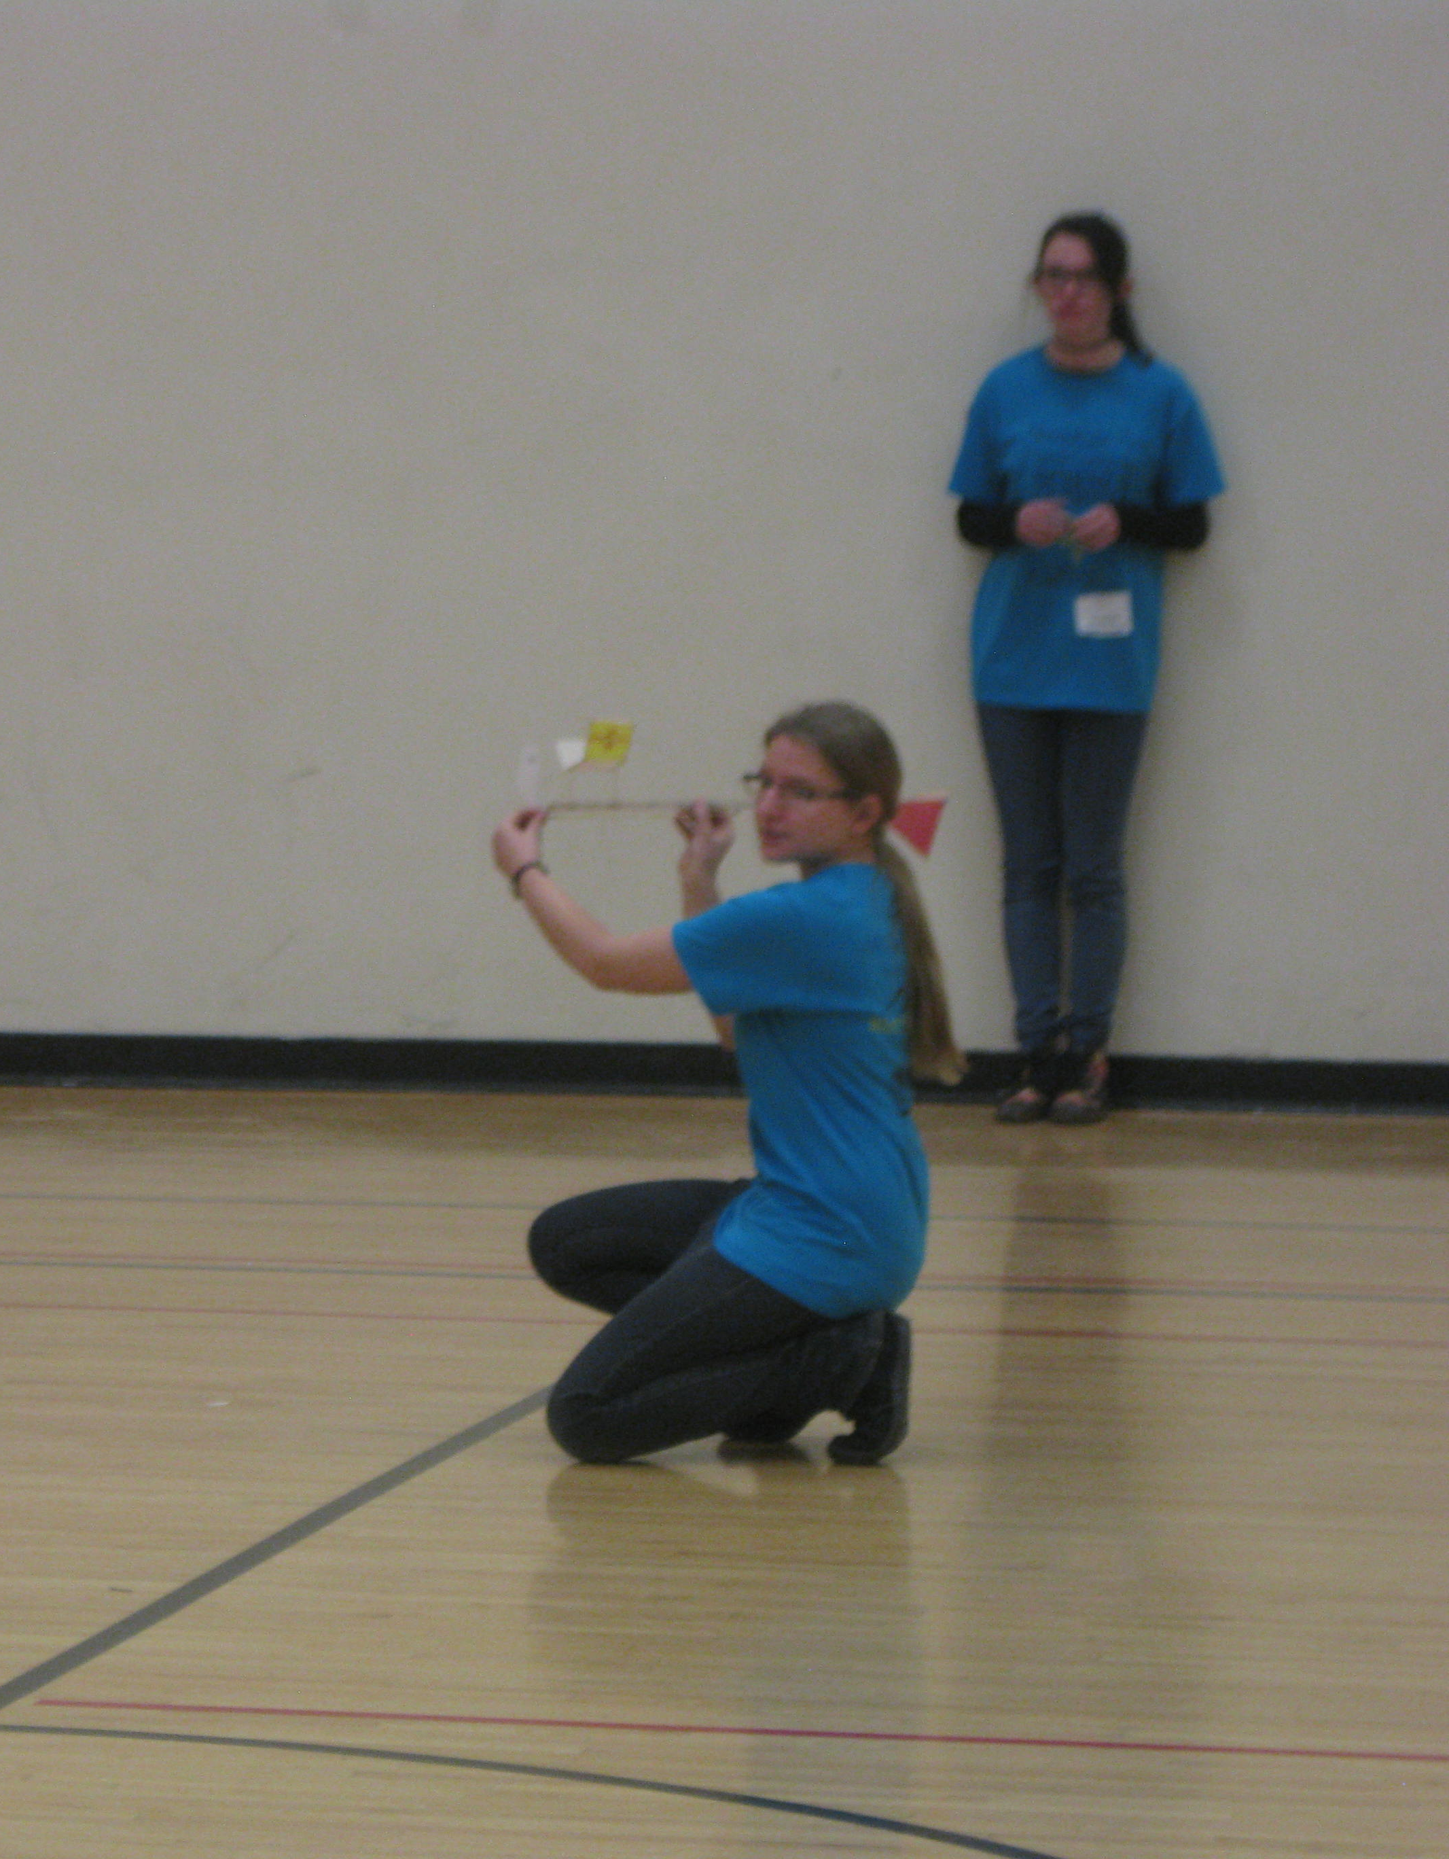
Flying Techniques

Slide 28
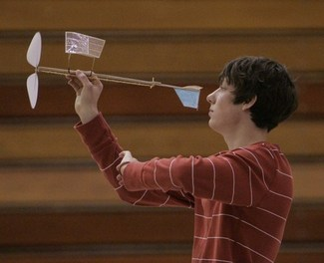
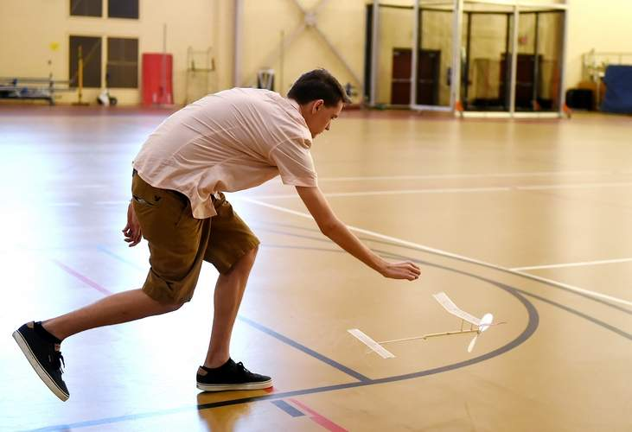
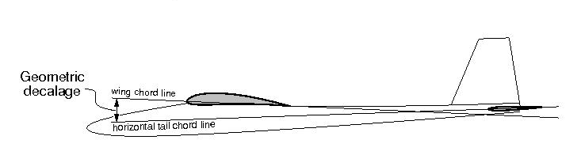
Trimming
Verify mass
  Check often, remove ballast as glue is added
  Use modeling clay
Verify CG (balance point) often (log it)
Decalage to about 3-8mm
Wind lightly, 400-600 turns on rubber
Launch straight ahead with light toss
Watch for stall
  Increase decalage until stall observed
  Decrease until stall just goes away
Watch for recovery from touches (ceiling)
  If dives, move CG forward and re-trim
  If quick recovery, may try more aft CG
Trimming may take one or more flying sessions

Slide 29
Trimming (cont.)
Higher power launches
Adjust launch torque to room height
If roll in, add inboard wing wash-in (raise leading edge of left, or inner wing)
  Common solution last year
Adjust for circle to fit in 50-60% of gym size
  Rudder has greater effect on high speed
  Tail tilt has greater effect on low speed

Slide 30
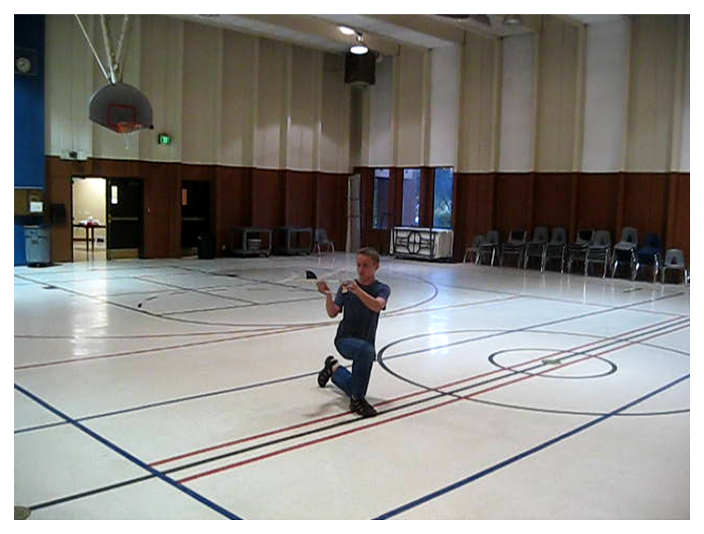
Flying
Record ALL parameters in log
  Change ONE THING at a time
Rubber/prop optimization is key
  Change props
  Adjust prop (pitch, flex)
  Rubber width, length
  Stopwatch tells the tale
  If it won’t climb, try thicker rubber, less pitch, or less diameter
Half rubber flights
  ½ altitude, ½ time
  ½ rubber length, same thickness
  Predictable higher ceiling performance
  Lower risk
  Replace ½ rubber with weighted stick
GET IN THE GYM
  Winning takes many flights

Slide 31
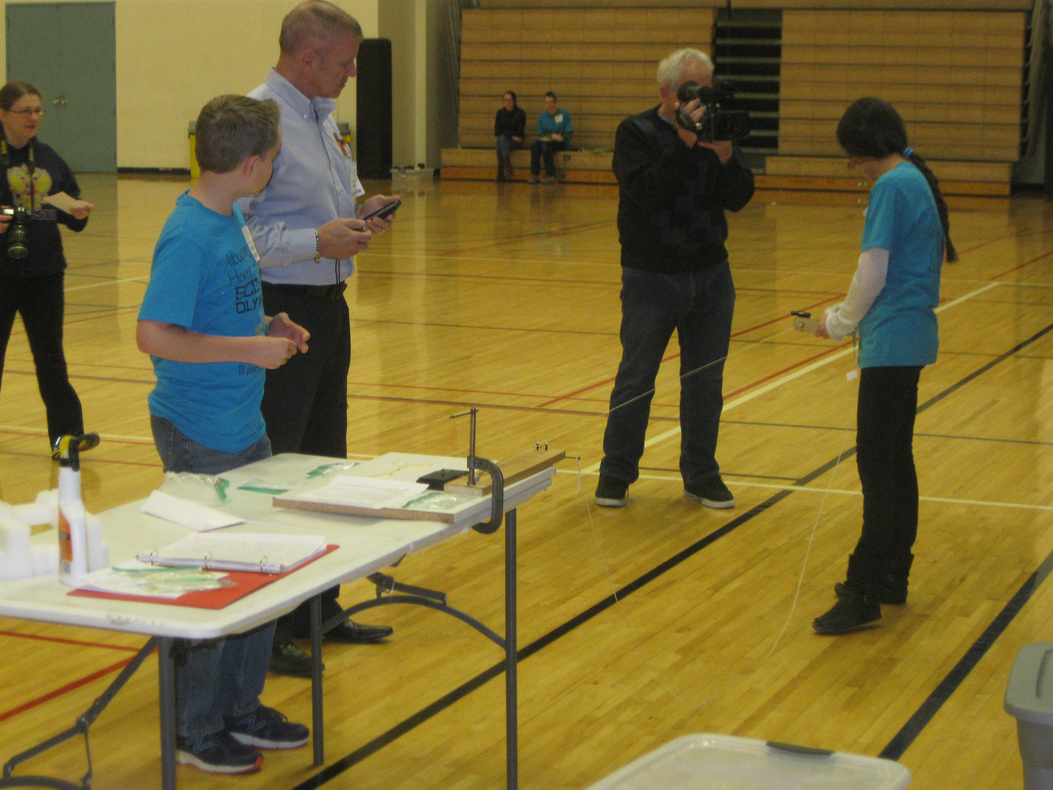
Flying
Rubber winding
  Hysteresis
  Wind off airplane!
  Torque meter
  Wind counting
  Lubricate
    Silicon oil
    Armor-all
  Wind to almost breaking (break some to know)
    Usually based on torque
  Back off to launch torque
    Ceiling height
Stretch winding
  Stretch to 5-8X length
  Wind ½ at full stretch, then walk in
Rubber evaluation
  Initial climb: Launch torque
  Cruise: rubber/prop balance
  Letdown: Prop flex
  Look at turns remaining
    Ideally about ½ row of knots

Slide 32
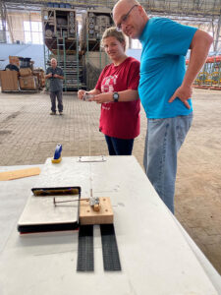
Flight Adjustments
If initial flights are decent, make SMALL changes and record differences
Dives:
  Increase decalage: Raise front of wing or back of tail stabilizer
  Move CG rearward
Stalls (nose climbs then dips repeatedly)
  Decrease decalage
  Move CG forward
Stalls only at high power
  Add down thrust (angle propellor shaft downward)
  Add incidence to BOTH surfaces (raise leading edge of wing AND stab)
Flight is ok but climb limited
  Decrease prop pitch
  Add left wing wash-in (raise left wing leading edge slightly)
  Increase decalage until stall, then back off slightly
    Decalage usually should be set for low-power flight

Slide 33
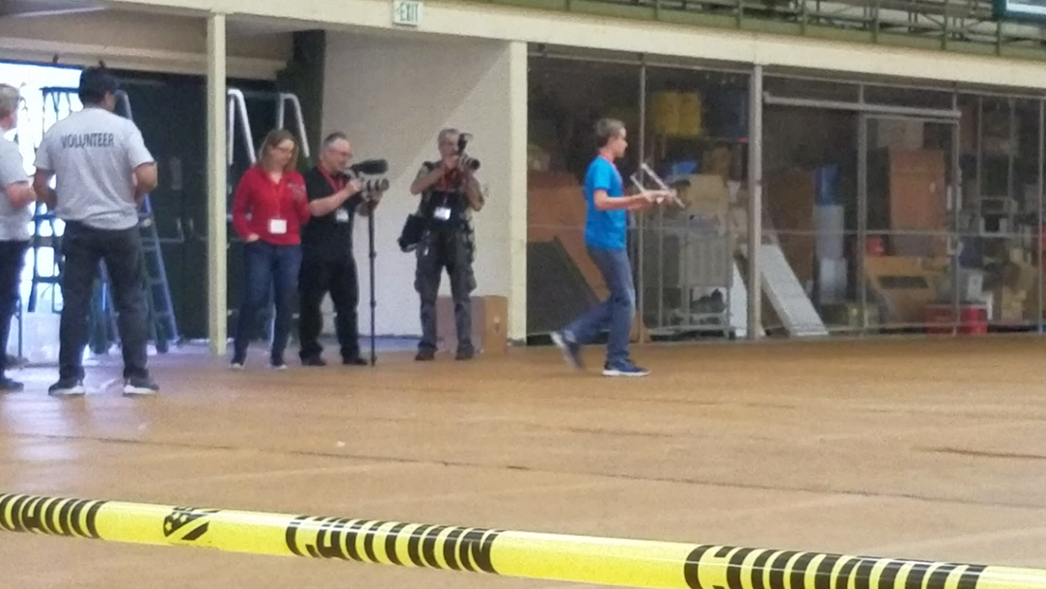
Follow-up
  Preferred followup is the Scioly Forum at https://scioly.org/forums
  Official rules clarifications are thorough the SO FAQ process ONLY

